Slide 1
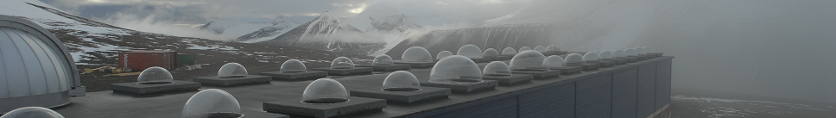

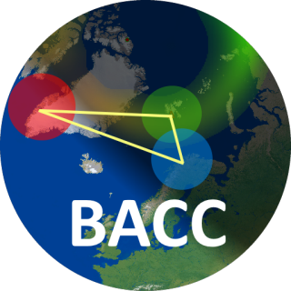
The Boreal Aurora Camera Constellation (BACC)
Fred Sigernes ^{1,2}, Dag A. Lorentzen ^{1,2}, Magnar G. Johnsen ³, Torsten Aslaksen ⁴,
Mikko Syrjäsuo ^{1,2}, Stefan Wacker ⁵, Jakob Abermann ⁵, Bjørn Lybekk ⁶,
Espen Trondsen ⁶, Lasse Clausen ⁶ and Jøran Moen ⁶
¹ The University Centre on Svalbard (UNIS), N-9171 Longyearbyen, Norway
² Birkeland Centre for Space Science (BCSS), Bergen, Norway
³ Norwegian Center for Space Weather, The Arctic University of Norway (UiT), Norway
⁴ Department of Electrical Engineering, UiT, Norway
⁵ Asiaq Greenland Survey, Nuuk, Greenland
⁶ Department of physics, University of Oslo, Norway
43rd Annual European Meeting on Atmospheric Studies by Optical Methods, 15-19 August 2016, Winchester, UK

Slide 2
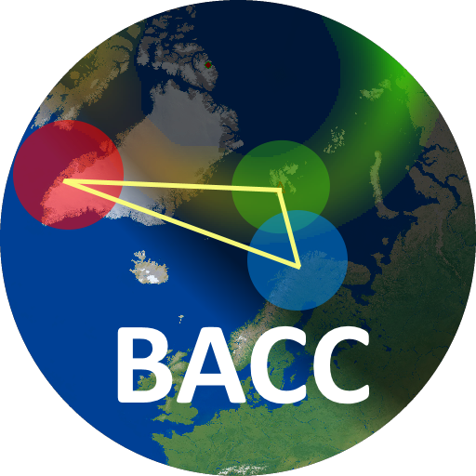
Boreal
Menu - Keywords
Motivation?
The camera station
Sensitivity and laboratory work
The camera network - constellation
Sample data
Color detection of aurora
Validation
Summary
Auroral
Constellation
Cameras:
Color
All-sky

Slide 3
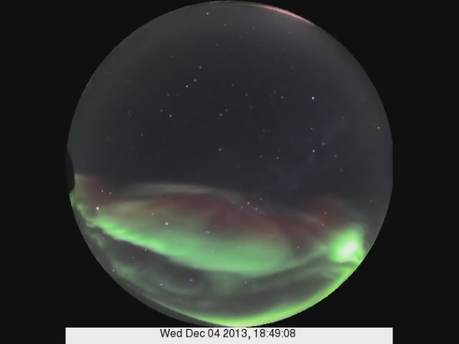
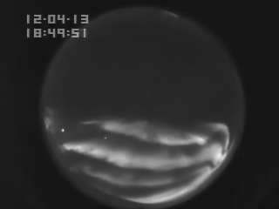
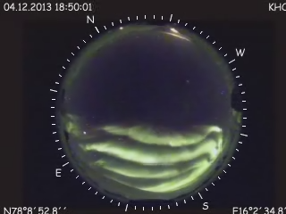
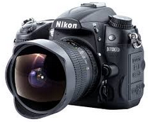
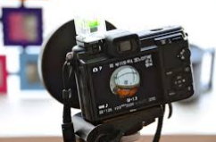
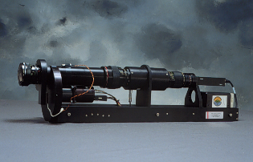
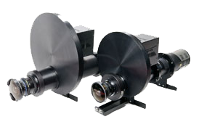
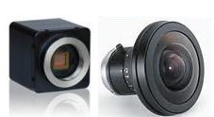
1. MOTIVATION
KHO
4th of December 2013
DSLR
Digital Single Lens Reflex
Circular Fisheye 180°
Time resolution: 5 - 30 s
Camera: Nikon D7000
Lens: Sigma 4.5mm f/2.8
Nikon D7000 -16M pixels
Color matrix: RGB
INTENSIFIED CCD
4th Gen Light intensified vacuum tube
Circular Fisheye 180°
Time resolution: 25 msec (real time)
Camera: Video CCD
NTSC: 30 frames /second
Monochrome
Frame accumulation ~1s (30 frames)
Color EMCCD camera
Electron Multiplying Charge Coupled Device
Circular Fisheye 185°
Time resolution: 25 msec (real time)
Camera: Raptor Hawk EM246
PAL: 25 frames / second
Color matrix: CYMG
Frame accumulation ~1s (25 frames)
Price (US $) : ~ 1K ~ 2K ~ 60K 60 - 90K ~9K

Slide 4
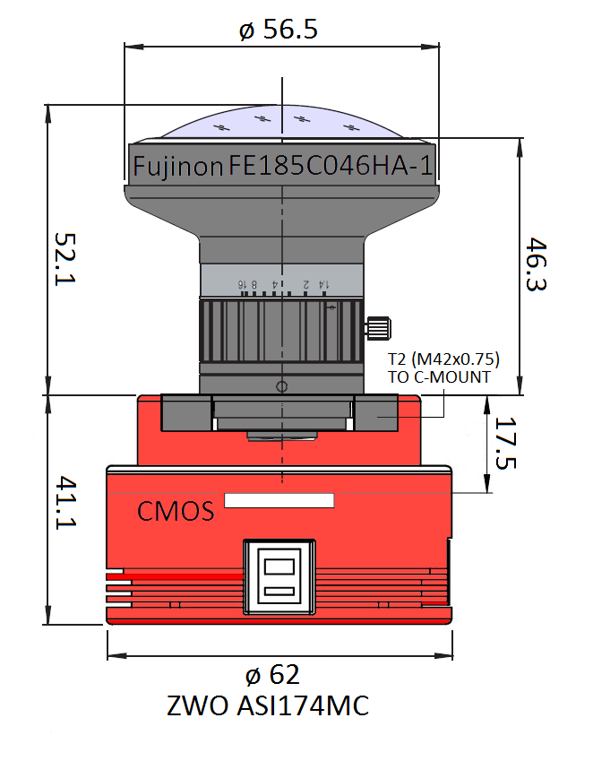
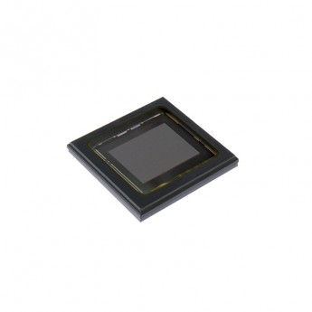
2. The camera station
Parts and cost camera station.
# | Item | Description (US$)
1 | Fujinon F/1.4 fish-eye lens | All-sky camera front optics 800
2 | C-mount to T2 Extension ring | Lens to camera head adapter 60
3 | ASI174MC | Color camera CMOS head 800
4 | USB Cables | 5m USB cable from computer 235
5 | BASH Camera housing | Protective outdoor dome cover 700
6 | Computer | PC windows 10 64-bit 1200
7 | Software | VNC license / Delphi 10 650
8 | Misc. | Packing, freight etc. 470
9 | Calibration | Mounting, focus and sensitivity 1200
 |  | Total $6116
IMX174 SONY Pregius
Resolution: 2.3 MP, 1920 x 1200
Manufacturer: Sony
Frame rate [fps]: 164.5
Sensor technology: CMOS
Shutter type: Global shutter
Pixel size [µm]: 5.86 x 5.86
Drawing of the ZWO ASI174MC camera head and the Fujinon F/1.4 all-sky lens. All numbers are in mm.

Slide 5
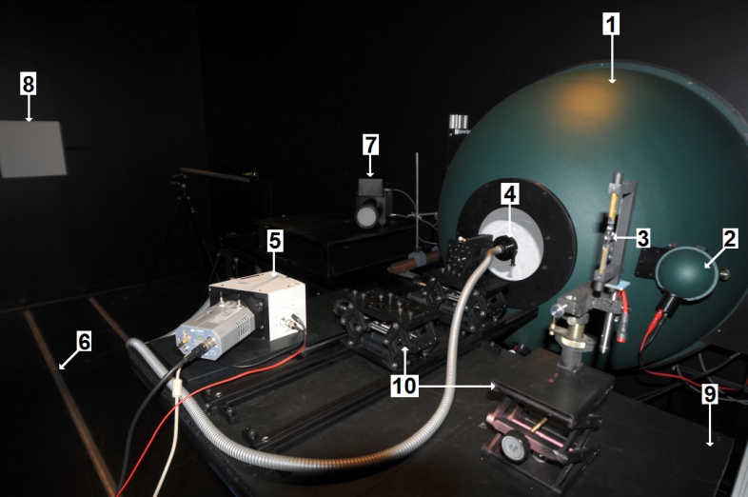
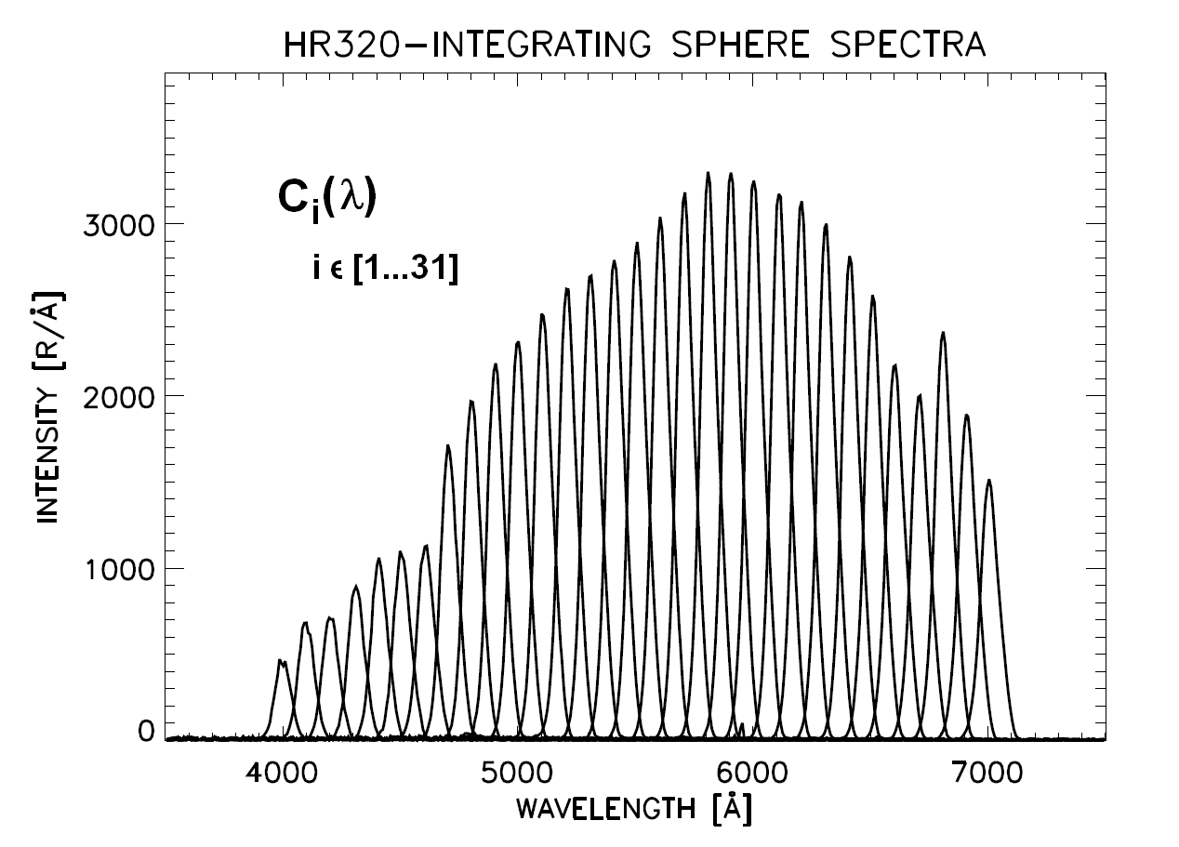
3. Sensitivity and laboratory work
3 step method:
Focus and radial mapping
Flat-field correction
Spectral responsivity
Experimental setup at UNIS optical lab: (1) Labsphere 1m diameter integrating sphere, (2) source lamp sphere, (3) Oriel 45W tungsten Lamp (FEL), (4) fiber bundle probe, (5) Oriel FICS 77443 spectrograph, (6) rail road, (7) Keo Alcor-RC lamp, (8) Lambertian screen, (9) adjustable table on rails, and (10) table jacks.
Monochromator output for calibration of spectral responsivity of color cameras

Slide 6
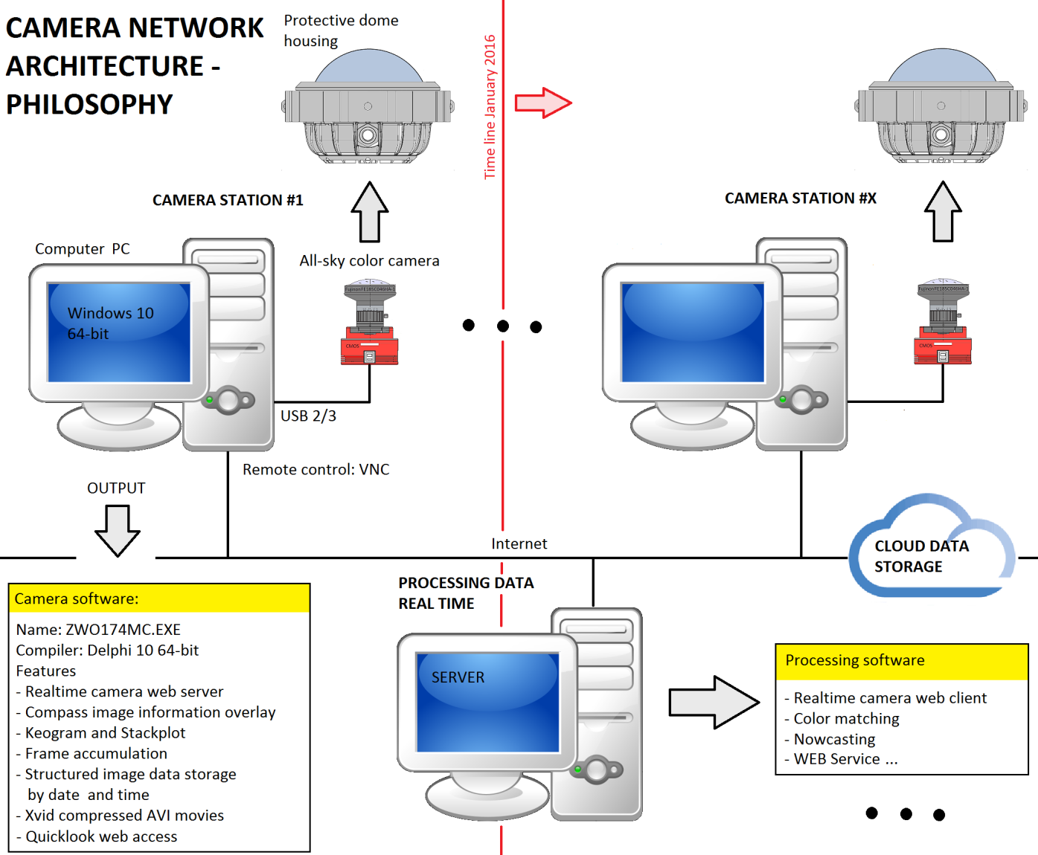
4. The camera network - constellation

Slide 7
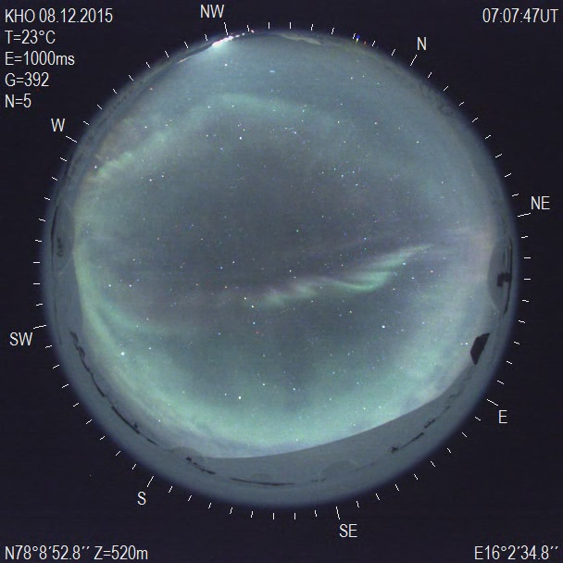
5. Pre noon Dayside aurora

Slide 8
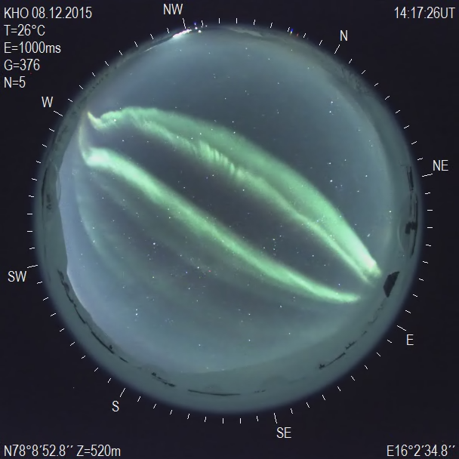
5. Post noon Dayside aurora

Slide 9
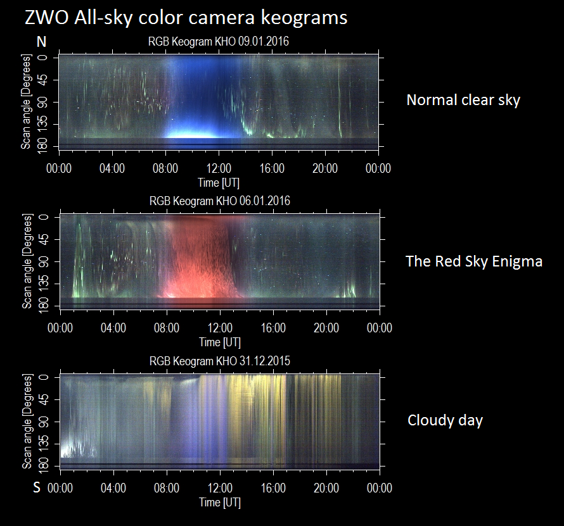

Slide 10
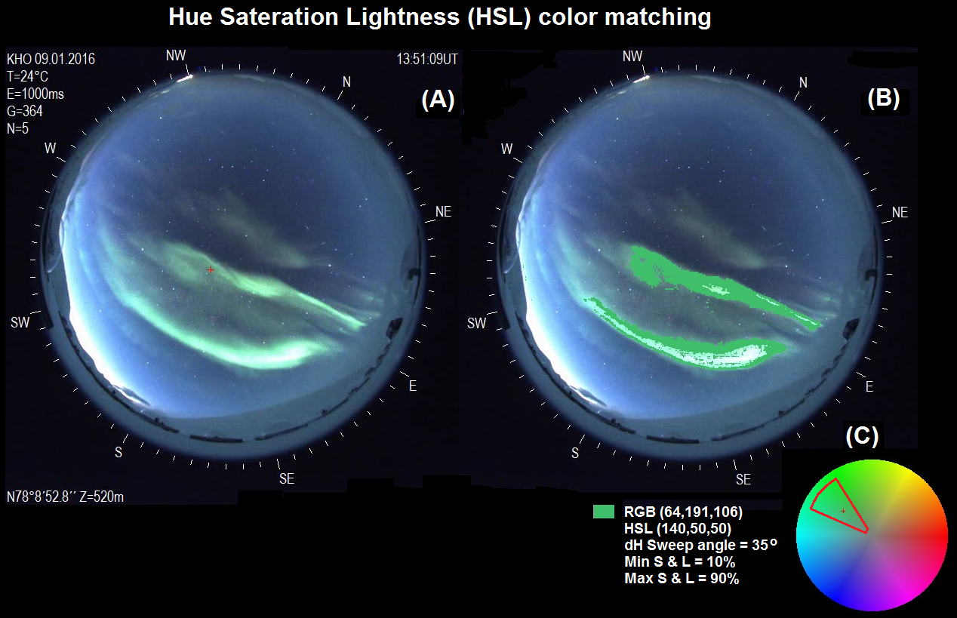
6. Color detection of aurora

Slide 11
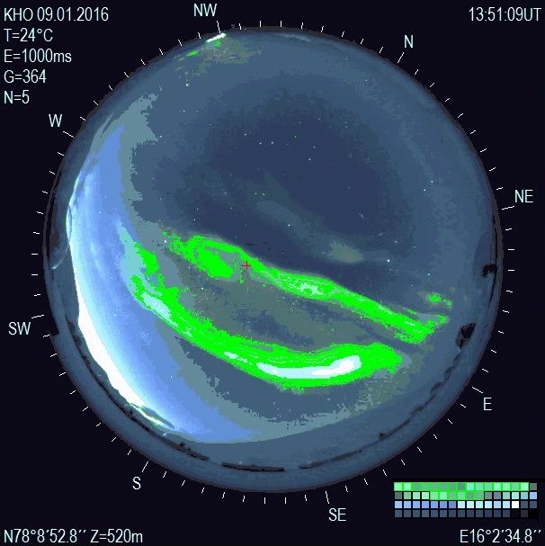
6. Color detection of aurora
Palette based color matching
Due to hardware limitations on number of colors to display on a computer screen back in the 80’s, the Graphics Interchange Format (GIF) developed by the company CompuServe Network, Inc. in 1987, provides optimized palette based methods to reduce high resolution color space images.
The graphics format is now included in Delphi with GIF extensions with variable size palette optimization methods.
More development needed to make the color detection robust.
.

Slide 12
7. Validation
Visual inspection of the processed frames will be matched by other instruments and techniques already present at KHO. Our hyperspectral all-sky cameras named NORUSCA are capable of isolating the main auroral emission lines as function of wavelength. A successful classification of both dayside- and nightside auroras has been conducted. The hyper- spectral data will be used to validate our color matching results.
8. Summary
A low cost auroral all-sky color camera station has been constructed and tested. It is the core component of the proposed boreal auroral camera network - constellation. The network aims to provide multi-site real time all-sky data across the boreal zone to enable detailed studies of various sky phenomena.
Details and references to methods we use:
http://kho.unis.no/Doc/BACC.pdf

