Slide 1
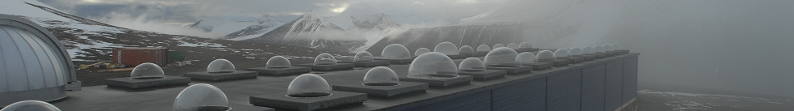

Color matching the aurora
Fred Sigernes,^{1,*} Jyrki Mattanen,² Dag Arne Lorentzen,^{1,*} and Charles Sterling Deehr ³
¹ The University Centre in Svalbard (UNIS), N-9171 Longyearbyen, Norway
² Arctic Research Centre of the Finnish Meteorological Institute, Finland.
³ Geophysical Institute, University of Alaska, Fairbanks, USA
* Birkeland Center for Space Science

Slide 2
Motivation
Color matrix EMCCD (Electron Multiplying Charged Coupled Devices) image detectors have become available to the auroral community to a reasonable price. The latter is due to increased surveillance and the astronomical use of this technology.
The sensitivity of the EMCCD is close to the Intensified CCD (ICCD). Monochromatic all-sky ICCD’s cameras have been used for decades to study auroral morphology with no emphasis on image segmentation based on color.
A relatively low cost all-sky EMCCD camera has been assembled and tested at the Kjell Henriksen Observatory (KHO). The camera is able to automatically detect aurora based on color matching at high frame rates. The results are compared to corresponding images from a Digital Single Lens Reflex camera (DSLR).

Slide 3
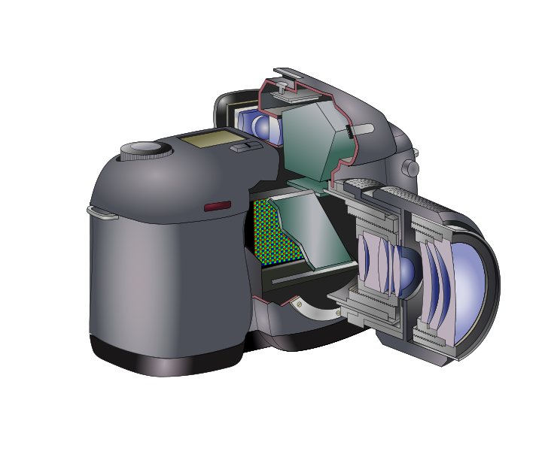
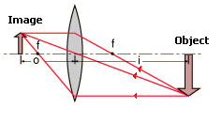
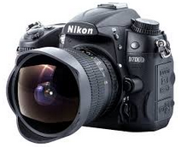
THE DSLR CAMERA
Aperture stop
The Digital Single Lens Reflex camera
CCD
Optical Diagram Camera
DSLR Cross section (Wikipedia)

Slide 4
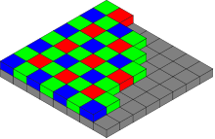
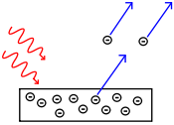
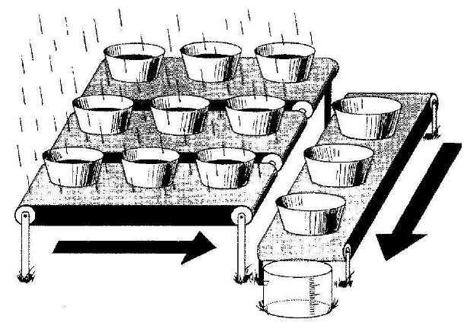
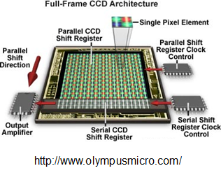
THE CCD
The Charged Coupled Device
The photoelectric effect
CCD with Bayer color filter mosaic
(Wikipedia)
Metals or non-metallic solids like
phosphorus doped silicon.
CCD Principle
Janesick et al. (1987)

Slide 5
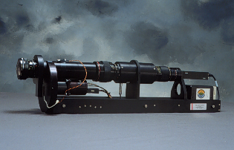
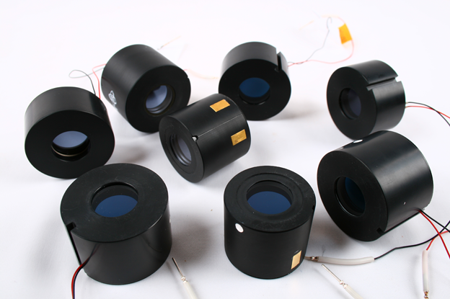
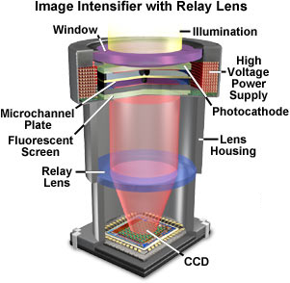
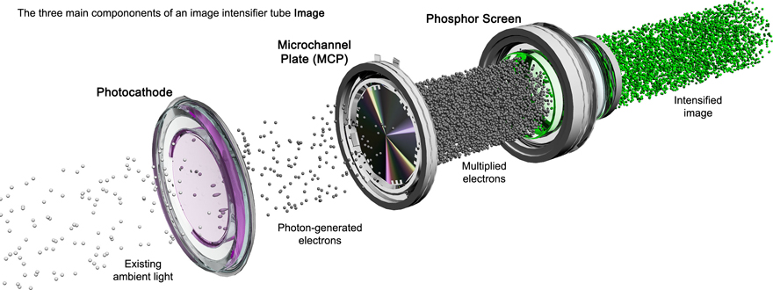
THE ICCD CAMERA
The Intensified Charged Coupled Device
http://www.photonis.com/
http://www.olympusmicro.com/

Slide 6
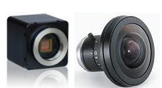
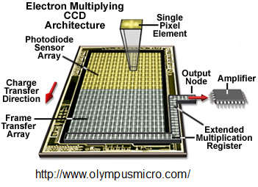
THE EMCCD CAMERA
Electron Multiplying Charged Coupled Devices
Raptor Hawk EM-246
Color EMCCD camera
Electron Multiplying Charge Coupled Device
Fujinon F1.4 Circular Fisheye 185°
Time resolution: 25 msec (real time)
PAL 25 frames / second
Color matrix: CYMG
Frame accumulation ~1s
Dimension: 43 x 43 x 50 mm³
Photoelectrons from the CCD are amplified by impact ionization through a high voltage serial register.

Slide 7
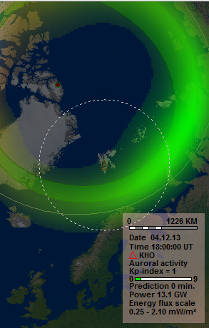
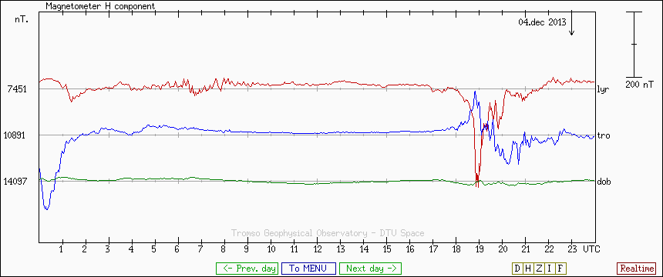
The Substorm of December 4, 2013
Longyearbyen
Tromsø
Dombås
An ordinary aurora that was associated with a co -rotating interaction region, CIT, in the solar wind. Originate from coronal holes on the sun.
Estimated Kp = 1

Slide 8
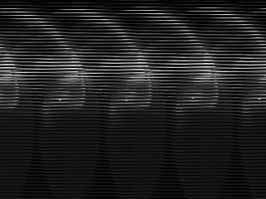
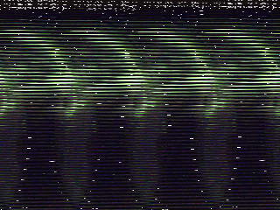

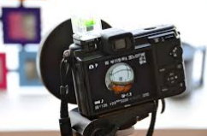
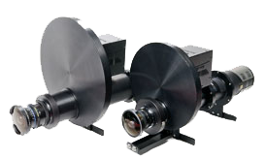
KHO
4th of December 2013
DSLR
Digital Single Lens Reflex
Circular Fisheye 180°
Time resolution: 5 - 30 s
Camera: Nikon D7000
Lens: Sigma 4.5mm f/2.8
Nikon D7000 -16M pixels
Color matrix: RGB
INTENSIFIED CCD
4th Gen Light intensified vacuum tube
Circular Fisheye 180°
Time resolution: 25 msec (real time)
Camera: Video CCD
NTSC: 30 frames /second
Monochrome
Frame accumulation ~1s (30 frames)
Color EMCCD camera
Electron Multiplying Charge Coupled Device
Circular Fisheye 185°
Time resolution: 25 msec (real time)
Camera: Raptor Hawk EM246
PAL: 25 frames / second
Color matrix: CYMG
Frame accumulation ~1s (25 frames)
Price (NOK) : 15K 10-15K 500K 500-800K 80K

Slide 9
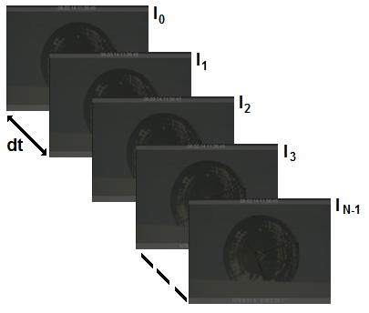
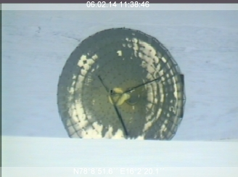
Frame accumulation
N=30
B=30
+ SCALING
The EISCAT Svalbard Radar (32m) seen from KHO
Simple sum:
Exponential moving average (EMA):
Reference: S. Massey and S. Quirk, Deep-Sky Video Astronomy, DOI: 10.1007/978-0-387-87612-2_2, Springer Science + Business Media, LLC 2009.

Slide 10
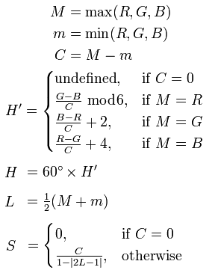
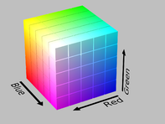
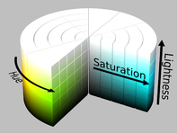
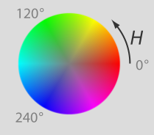
Color space to use on Auroral images ?
RGB (Normalized)
HSL
L=0.5
H – Hue represent the basic colors 0 – 360º
S – Saturation is purity of the color in % (white mixed with hue).
L – Lightness represent intensity in %.
Figures and equations from Wikipedia: “HSL and HSV”

Slide 11
Why use the HSL color space ?
Based on Human color perception. Humans distinguishes H easily, but not S and L when it comes to colors separation.
Gray-level algorithms works fine on L.
Useful where illumination levels varies, because H is invariant to certain types of highlights, shading and shadows. H can be useful for separating objects with different colors.
Simple example:
Color | R | G | B | H | S | L
 | 38 | 115 | 38 | 120 | 50 | 30
 | 64 | 191 | 64 | 120 | 50 | 50
 | 179 | 230 | 179 | 120 | 50 | 80
Disadvantages: Non-removable singularity near center axis and numerical unstable at low S due to nonlinear transformations. HSL is device dependent!
Reference: H.D. Cheng, X.H, Jiang, Y. Sun, and J. Wang, Color image segmentation: advances and prospects,
Pattern Recognition, 34, 2259-2281, 2001.

Slide 12
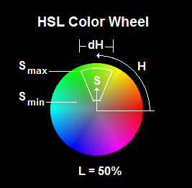
Color segmentation by HSL thresholds
Method: We define the target to have colors that are defined inside a color cake slice as sketched to the left. The sweep angle of the cake slice is dH, the length ΔS=(S_{max}-S_{min}) and the height ΔL= (L_{max}-L_{min}).
Each RGB color pixel in the images are converted to the HSL color space and classified according to the above criterion.
Advantage:
The algorithm is computer efficient (~10 msec on 320x240 pixels @ 25 frames/s).
It can be performed in real-time to automatically now-cast auroral activity.

Slide 13
DSLR Sample

Slide 14
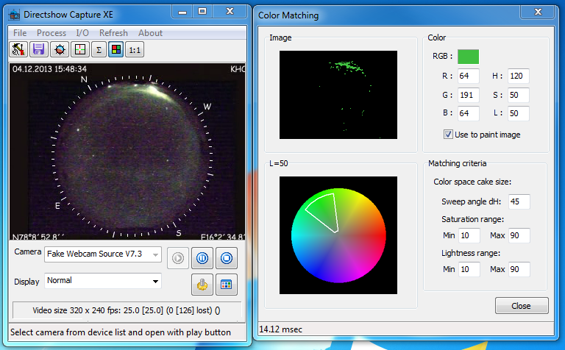
EMCCD Sample

Slide 15
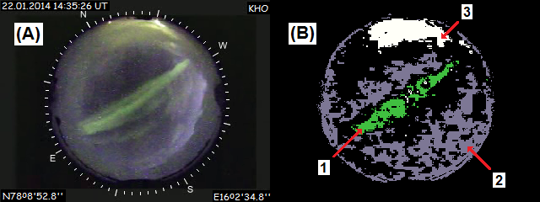
Sample: Post noon East – West aligned arc
Post noon East-West align auroral arc as seen from the Kjell Henriksen Observatory (KHO) on the 22nd of January 2014 at 14:35:26 UT. Panel (A) shows a 1 second all-sky video accumulated EMCCD color image. Panel (B) is the corresponding color matched image: (1) aurora, (2) background Sun/Moon illuminated sky and clouds, and (3) light pollution from Longyearbyen.

Slide 16
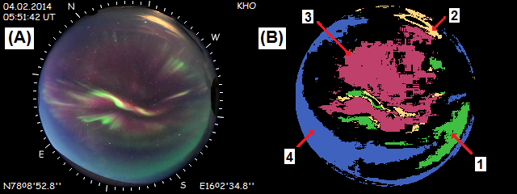
Sample: Pre-noon Dayside Aurora
Pre-noon dayside aurora as seen from the Kjell Henriksen Observatory (KHO) on the 4th of February 2014 at 05:51:42 UT. Panel (A) shows a 10 second exposed image from a Nikon D7000 DSLR all-sky color camera. Panel (B) is the corresponding color matched image: (1) green aurora, (2) light pollution from Longyearbyen, (3) red aurora, and (4) Rayleigh scattered light from the Sun.

Slide 17
Improvements
The algorithm is only pixel by pixel based. Clustering to obtain target size and shape on a larger scale could improve the detection decision / classification.
Auroras moves fast. Ambient light pollution does not move fast in-between frames. Movement could be implemented into the detection algorithm to improve classification of aurora.
Combine 1. and 2.
….

Slide 18
Concluding remarks
A simple real-time method to automatically detect aurora by color is presented. Each RGB pixel in the all-sky images are converted to the Hue Saturation Lightness (HSL) color space.
The auroral color is defined to be within a green centered (H=120º) cake sliced section of the cylindrical HSL space. The sweep angle dH of the cake slice is ~45º. The length ΔS and height ΔL of the slice are within approximately 10 – 90%, respectively.
The method successfully detects aurora, light pollution, and background sky conditions including twilight and moon illuminated cloud cover.

