Slide 1
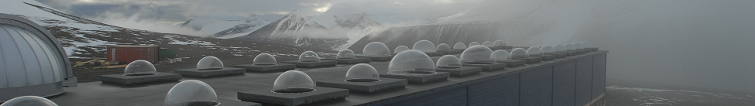
BASIC HYPER SPECTRAL IMAGING
Fred Sigernes ^{1,2,3,4}
¹ The University Centre in Svalbard (UNIS), N-9171 Longyearbyen, Norway
² The Birkeland Centre for Space Science (BCSS)
³ The Kjell Henriksen Observatory (KHO)
⁴ Centre for Autonomous Marine Operations and Systems (AMOS) NTNU
Lectures: TTK20 Hyperspectral remote sensing, Module 1, AMOS – NTNU, 11-13 September, 2018.

Slide 2
Lecture plan:
TTK20 Hyperspectral remote sensing
Module 1
Instructor: Adjunct Professor Fred Sigernes
Day 1
09:15 – 11:00 | Basic Spectroscopy
13:15 – 15:00 | Spectral Designs
Day 2
09:15 – 11:000 | System Optics
13:15 – 15:00 | Throughput and Etendue
Day 3
09:15 – 11:000 | Calibration
13:15 – 15:00 | Imaging spectroscopy
Lectures: TTK20 Hyperspectral remote sensing, Module 1, AMOS – NTNU, 11-13 September, 2018.

Slide 3
DAY 1: SPECTRAL DESIGNS
The lens (2D)
Lens 1
q
Image
Optical axis
Object
p
f₁
f₁= focal length
Optical axis

Slide 4
The prism spectrogram (2D)
Lens 1
Prism
Pinhole
Lens 2
Input
Light
Image plane
f₁
f₁= focal length
f₂
The result is a prism spectrograph.
We could call it a pinhole color separator.
It images the pinhole as a function of wavelength (color).

Slide 5
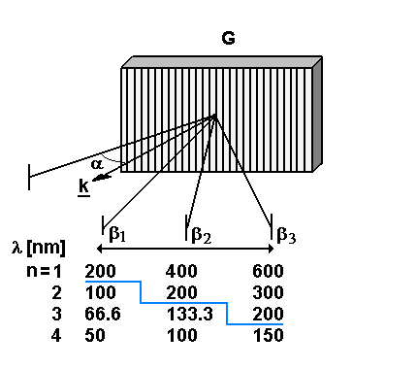
The plane transmission spectrograph (2D)
Lens 1
Grating
Pinhole
Lens 2
Input
Light
Image plane
f₁
f₁= focal length
f₂
The result is a Grating spectrograph.
It diffracts opposite in color compared
to the prism spectrograph.

Slide 6
The spectrogram – We use a slit instead of pinhole (3D)
Hg 435.8 nm
Hg 546.1 nm
SOURCE:
White paper illuminated by regular OSRAM low pressure gas discharge tube (office lamp).
Slit height [px]
Sodium Doublet
Na 589/589.6 nm.
Bandpass ~ 1nm
Wavelength [px]
Range = [355 – 720 nm]

Slide 7
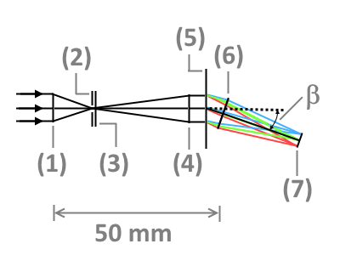
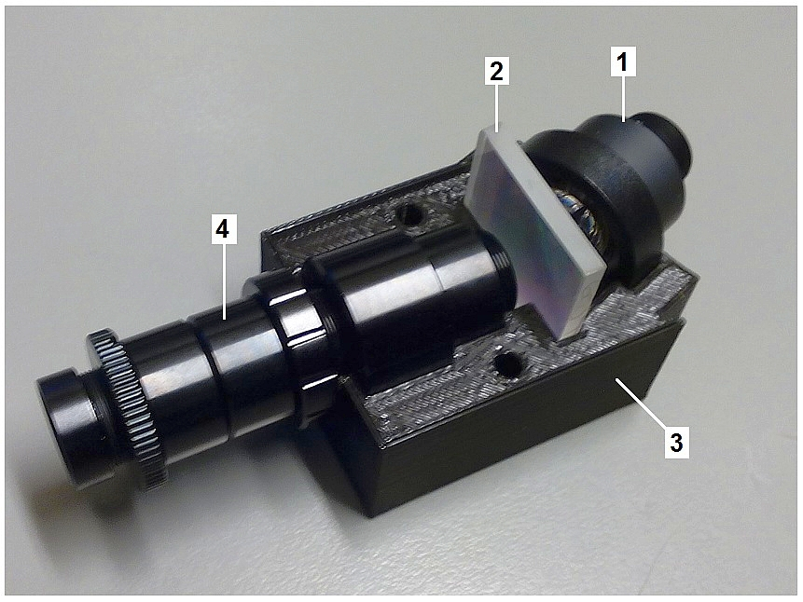
Miniaturized plane transmission grating spectrographs NTNU V2 – V5
Optical diagram: (1) front lens, (2) entrance slit, (3) field lens, (4) collimator lens, (5) 600 lines/mm transmission grating, (6) detector lens, (7) exit focus plane. Center detector diffraction angle β = 19.36º for wavelength λ = 552.5 nm for first spectral order (n = 1).
Model 2 snap together transmission grating holder: (1) detector lens, (2) 25×25 mm² square 600 grooves/mm transmission grating, (3) 3D printed grating holder, and (4) Collimator-slit-front-optics assembly.

Slide 8
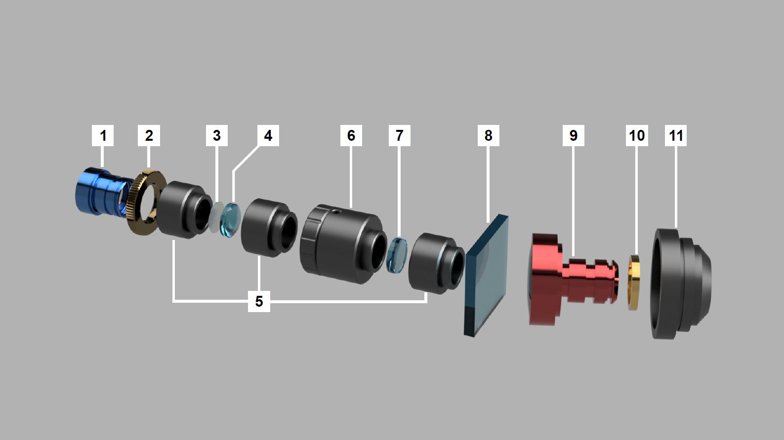
Exploded view of Hyper Spectral Imager (HSI) components: (1) front lens, (2) lock nut, (3) air slit, (4) field lens, (5) three thin lens mounts, (6) focus tube, (7) collimator lens, (8) transmission grating, (9) detector lens, (10) focus spacers, and (11) C-mount lens adapter.

Slide 9
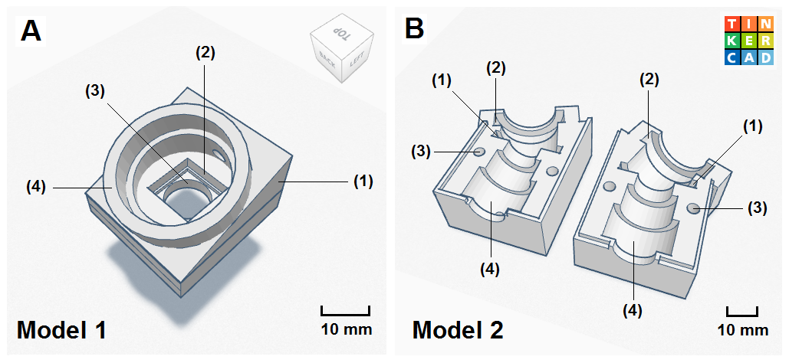
A 3D view of transmission grating holders using the Tinkercad program from the company Autodesk Inc.. Panel (A) Model 1: (1) 19.36º wedge, (2) square 12.5×12.5 mm² mount chamber for a 600 grooves/mm transmission grating, (3) 12 mm diameter hole for the Collimator-slit-front-optics assembly, and (4) cylindrical 25 mm diameter detector lens holder. Panel (B) Model 2: (1) 25×25 mm² square grating holder, (2) detector lens holder, (3) straight through mount holes, and (4) Collimator-slit-front-optics assembly holder.

Slide 10
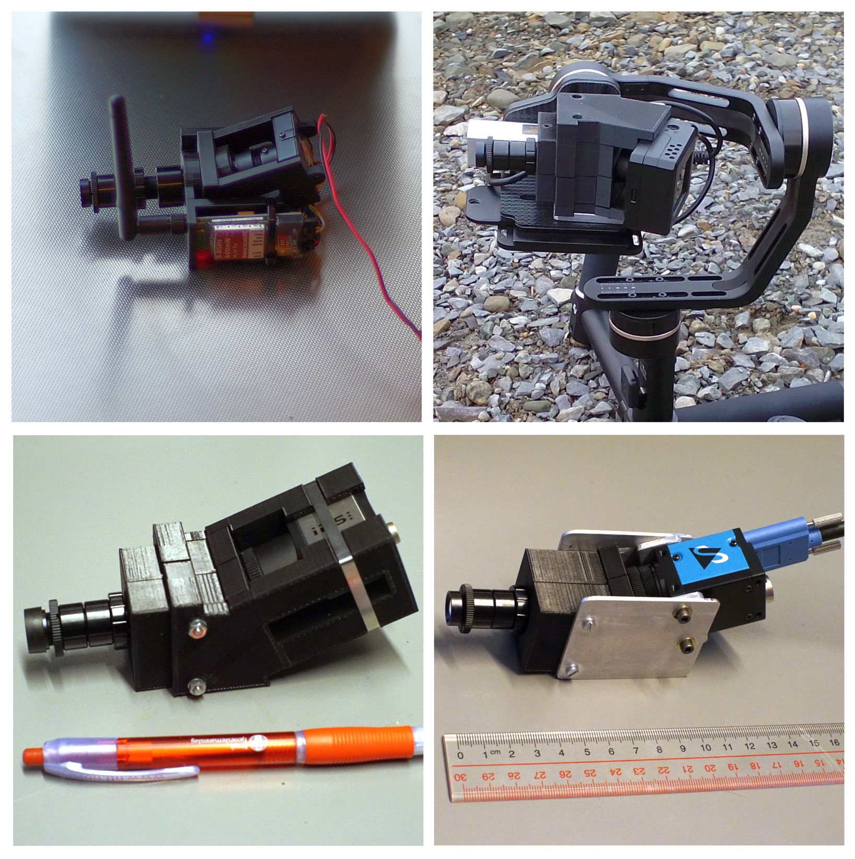
V2
V3
NTNU HSI
V2 – V5
Limitations
S – mount
F/# = 4
AS = 9 mm
Daylight
Mass < 170g
V4
V5

Slide 11
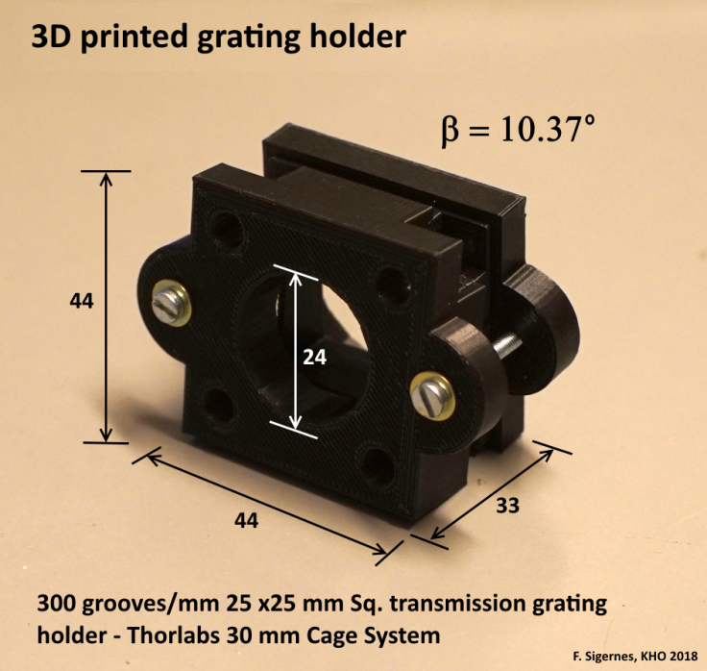
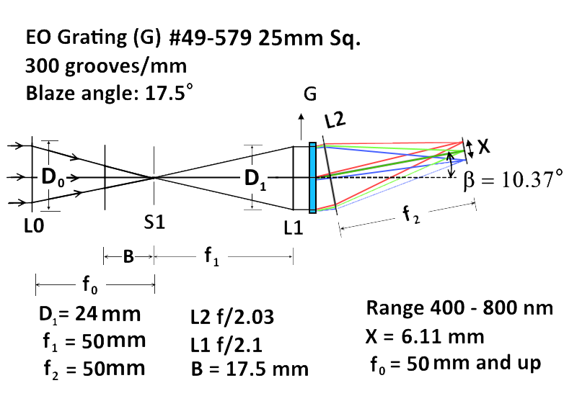
V6

Slide 12
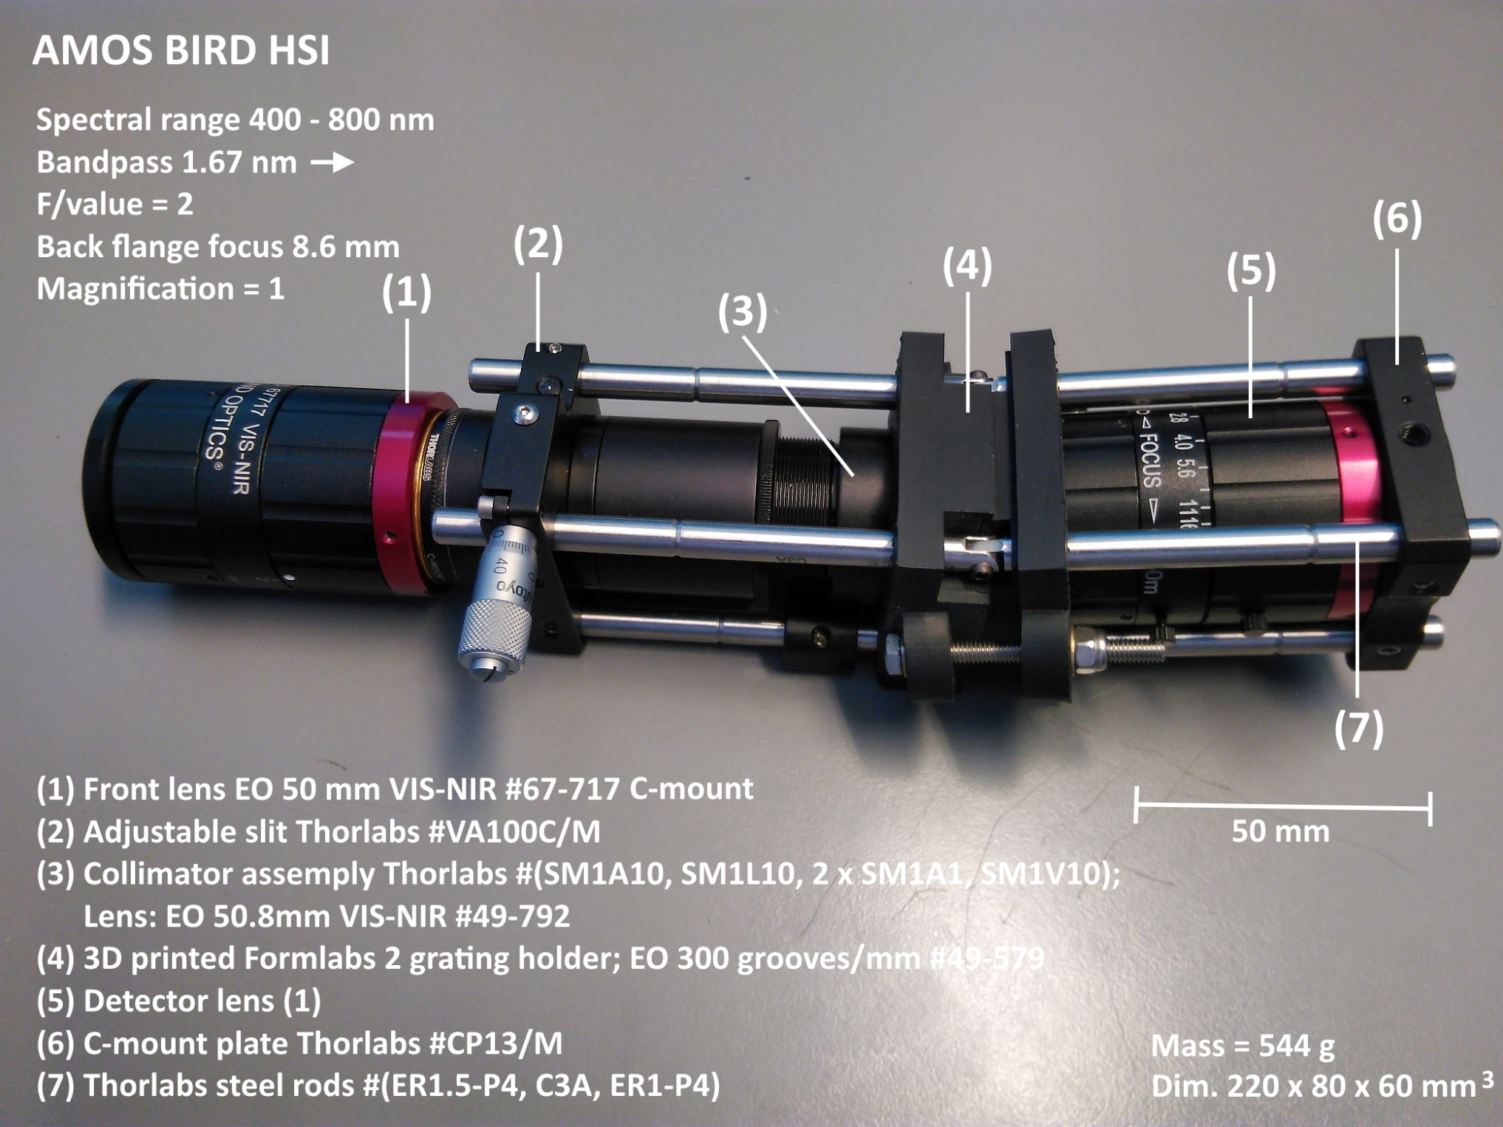
V6

Slide 13
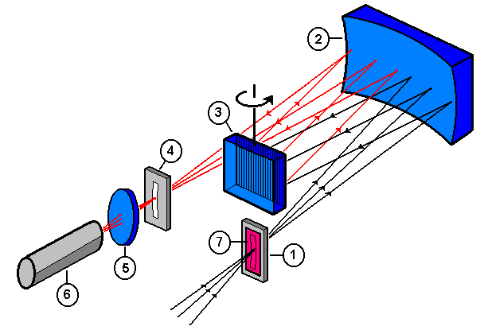
The Ebert – Fastie Spectrometer
In 1889 Herman Ebert described a spectrometer using a spherical mirror and a plane reflecting grating. Also known as a Plane Grating System (PGS).
In 1952 William G. Fastie improved the performance of the instrument, using curved slits instead of straight slits to reduce aberrations from the mirror
The Ebert-Fastie spectrometer: (1) curved entrance slit, (2) concave mirror, (3) plane reflecting grating, (4) curved exit slit, (5) collector lens, (6) photon counting detector, and (7) order sorting cut-off filter.

Slide 14
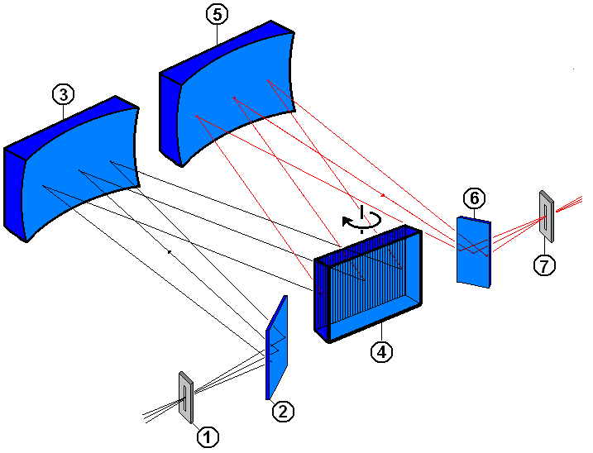
The Czerny-Turner configuration
In 1930 M. Czerny and A. F. Turner described a spectrometer using two concave mirrors. It is clearly equal to the Ebert-Fastie configuration, but it is more flexible. The mirrors may now have different focal lengths, size and position compared to the more rigid design of the Ebert-Fastie.
The two flat mirrors labelled (2) and (6) are just used to make the design more compact. They are not used in the original layout.
The Czerny-Turner configuration: (1) entrance slit, (2) flat mirror, (3) concave mirror (collector), (4) reflective grating, (5) focusing mirror, (6) flat mirror, and (7) exit slit.

Slide 15
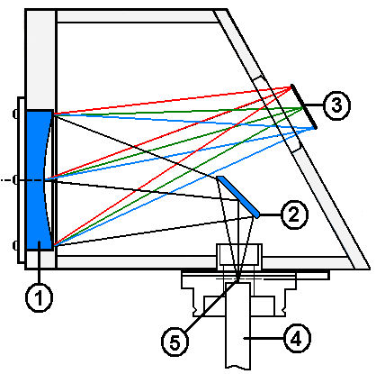
The FICS concave grating spectrograph
Back in 1883 Henry Augustus Rowland invented the concave grating at the John Hopkins University. It both collimates and focuses the incident light beam. No extra mirrors or lenses are required.
Today, holographic ion-beam etching techniques produce blazed concave gratings with high groove density and excellent image quality.
The design is compact with no moving parts, and it has a high aperture (f/value = 2). The spectral range is 400-1100 nm.
ORIEL Fixed Imaging Compact Spectrograph (FICS ): (1) concave holographic grating, (2) flat mirror, (3) detector (CCD), (4) fiber bundle, and (5) entrance slit.

Slide 16
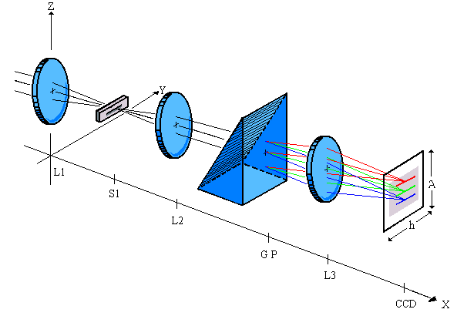
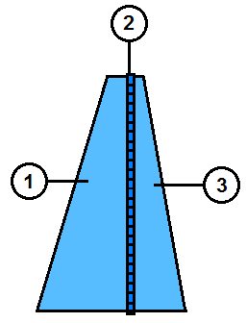
The GRISM spectrograph
One popular design is the use of a GRISM as dispersive element. This design makes it possible to obtain a straight through center wavelength parallel the optical axis of the system.
The optical elements may be stacked head on (on-axis). The on-axis design reduces geometrical aberrations such as astigmatism and coma. The image quality is high compared to off-axis systems.
PGP-element. (1) Prism,
(2) Grating
(3) Prism.
The GRISM spectrograph: L1 front lens, S1 entrance slit, L2 collector lens, G grating, P prism, L3 camera lens and CCD imaging detector

Slide 17
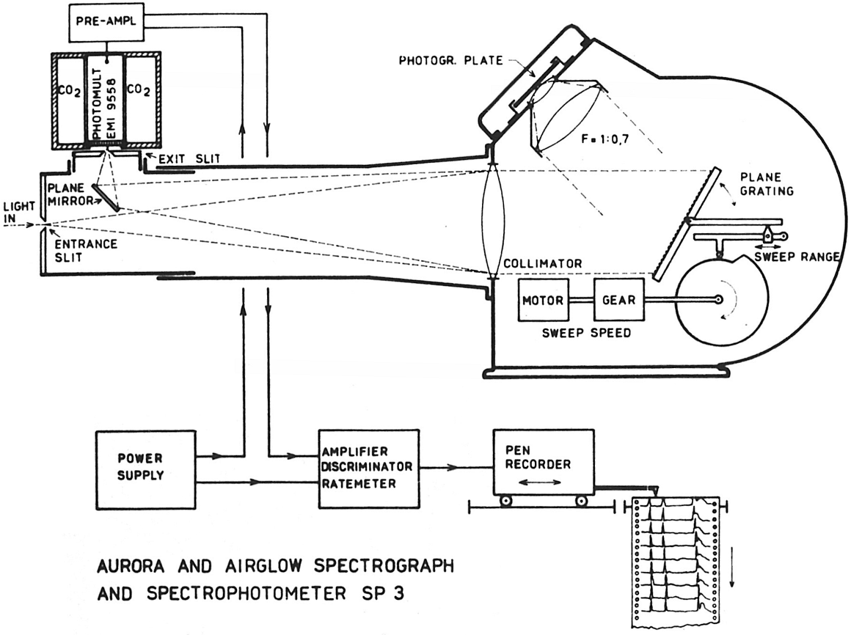
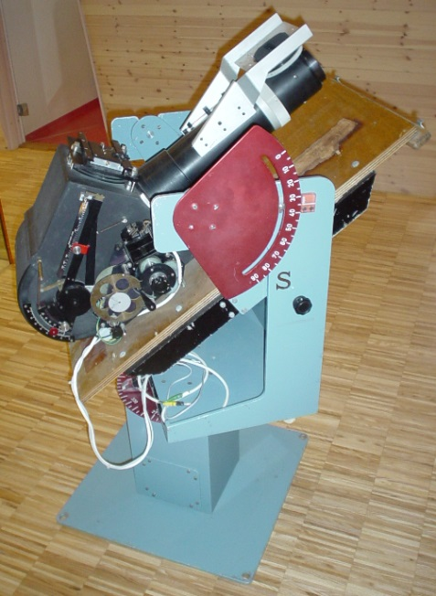
The Auroral Spectrophotometer number 3 (SP3)
The SP3 at UNIS (2006). ½ m focal length.
The SP3 combined spectrograph and Littrow spectrometer
The SP3 constructed in 1960 by Willy Stoffregen at the Ionospheric Observatorium in Uppsala, Sweden. It was used extensively by his student Kjell Henriksen to study aurora, airglow and star spectra.

Slide 18
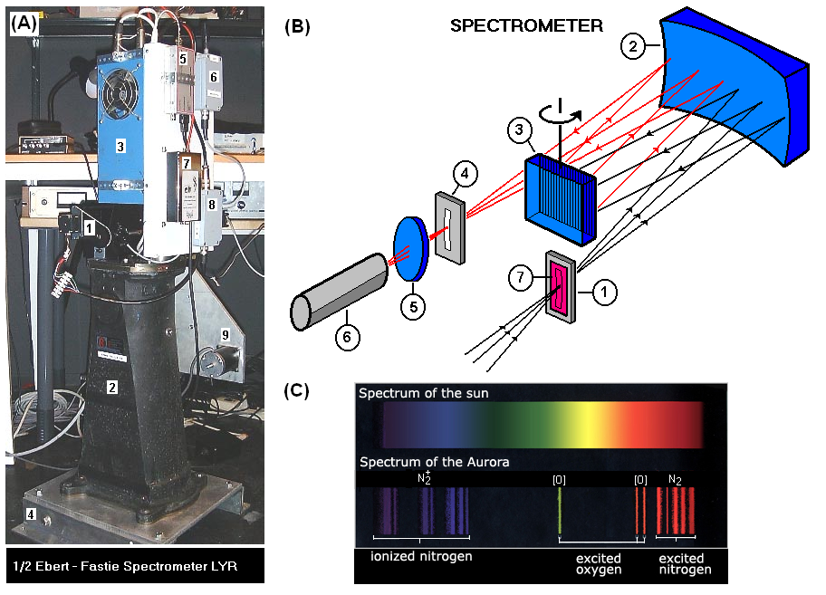
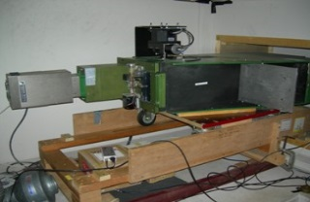
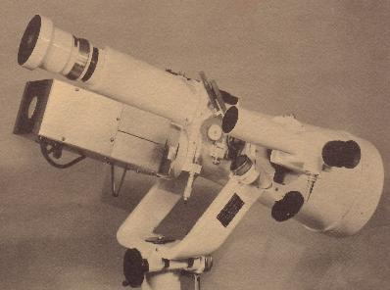
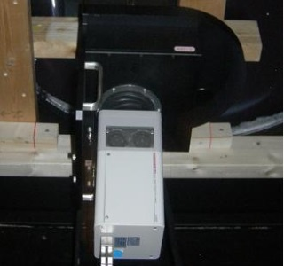
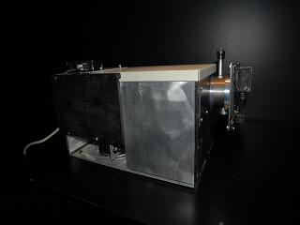
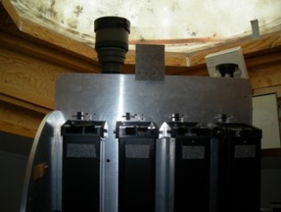
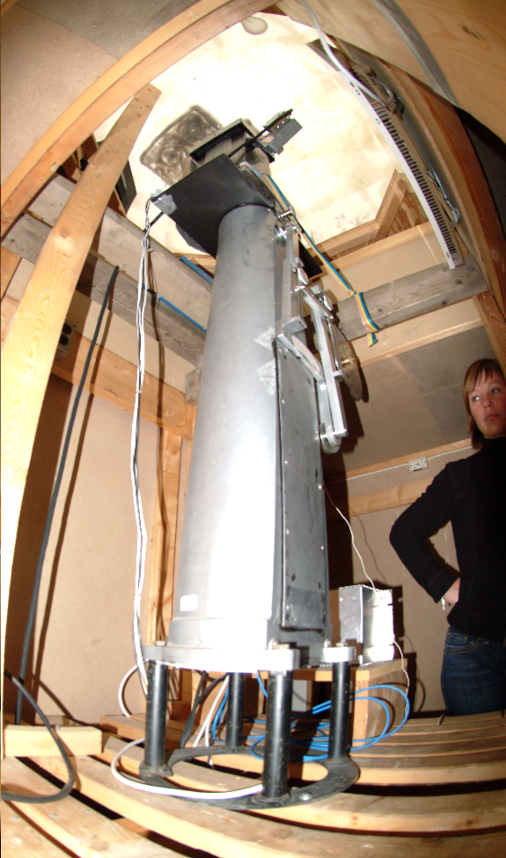
Spectrometers - Spectrographs @ KHO
Custom made instruments (MNOK)

Slide 19
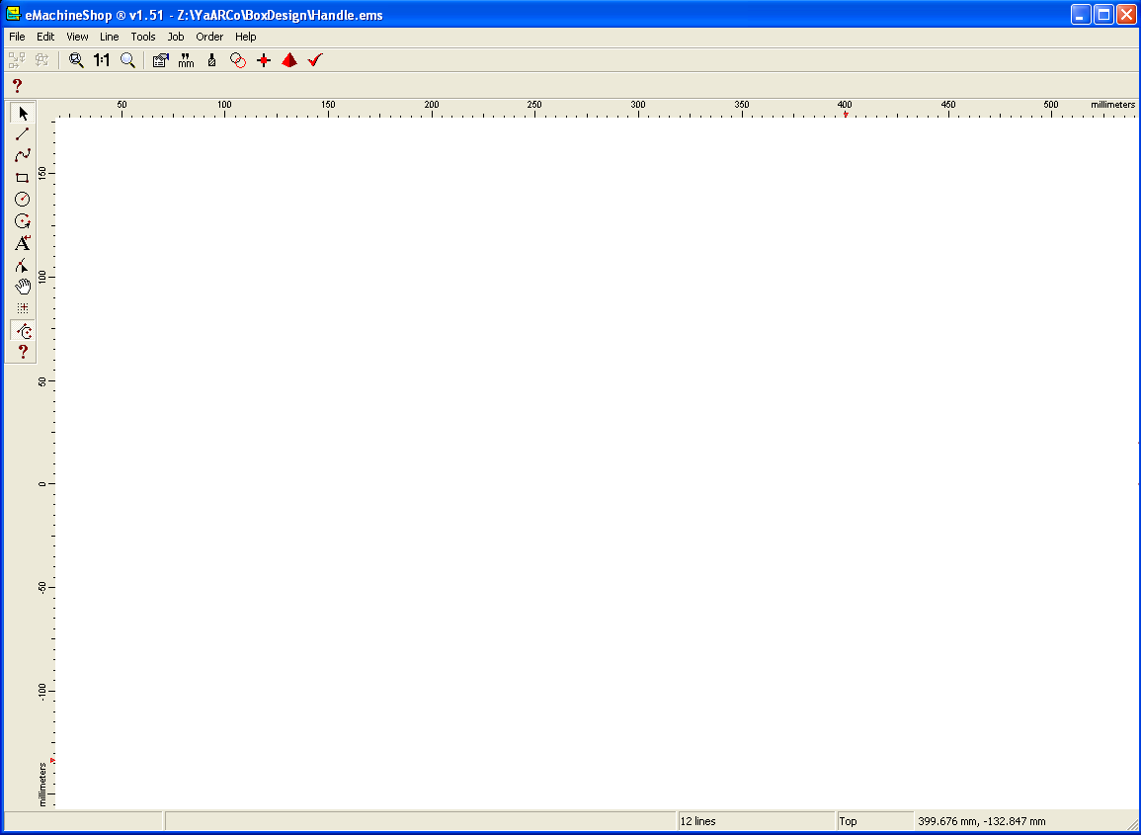
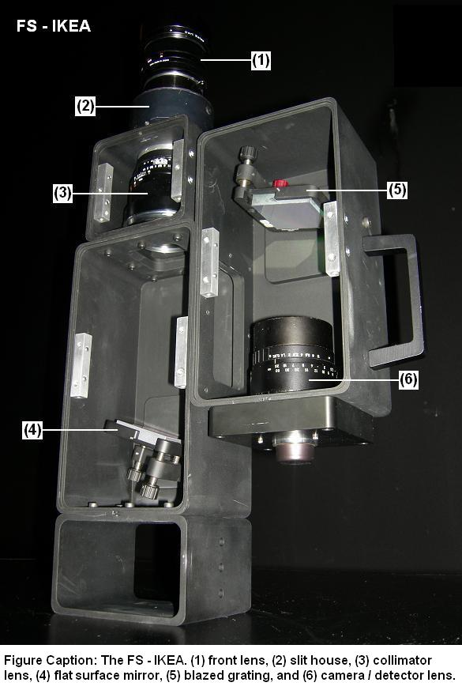
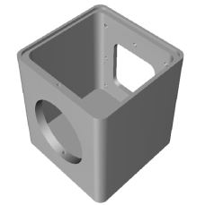
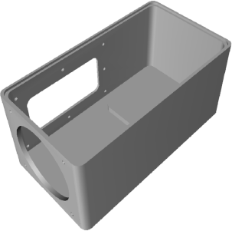
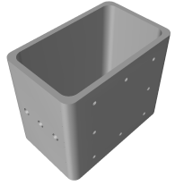
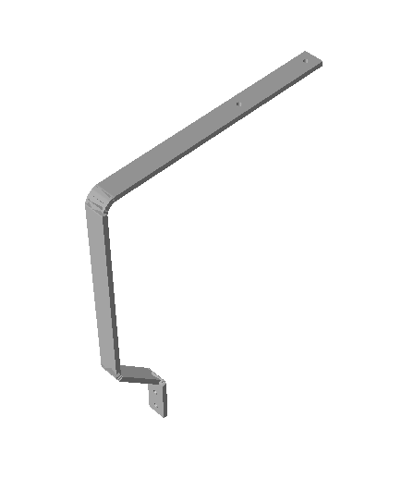
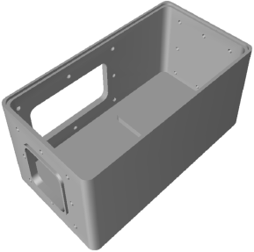
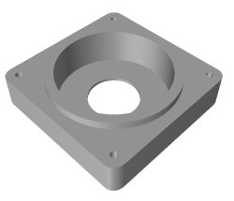
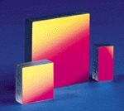
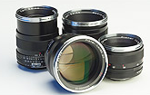
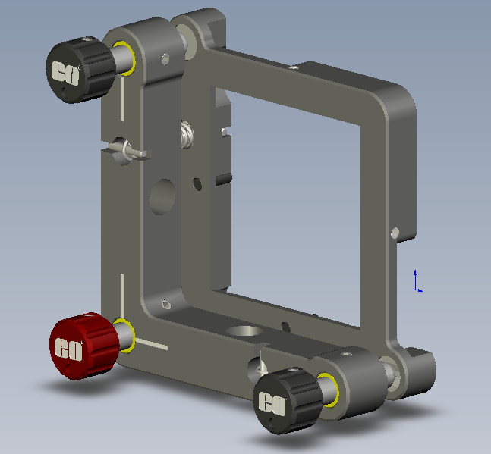
NEW TYPE OF INSTRUMENT DEVELOPMENT
EXAMPLE 1: HYPERSPECTRAL IMAGER
FS-IKEA
~14 days
?
Electronic Machine
Shops
EMCCD Andor Luca R
Purchase optics and mounts

Slide 20
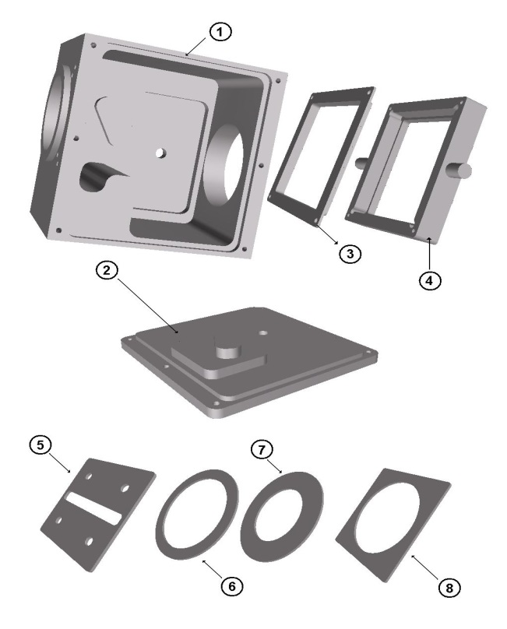
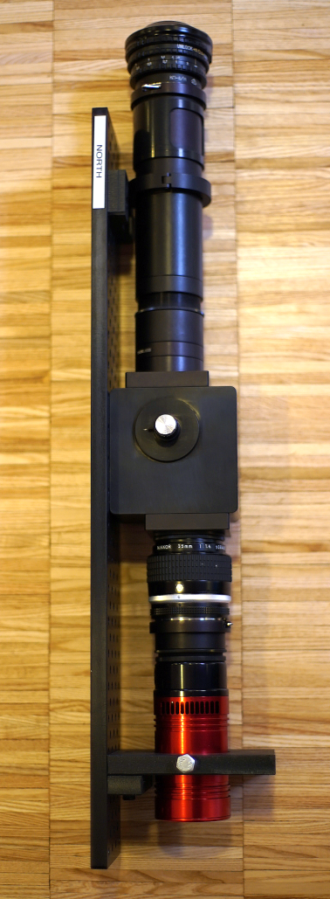
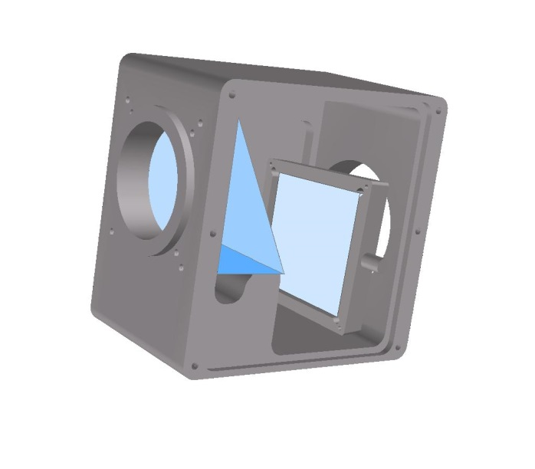
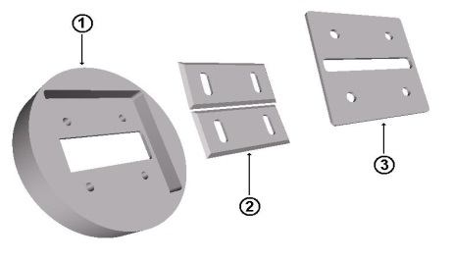
NEW TYPE OF INSTRUMENT DEVELOPMENT
EXAMPLE 2: no. 1 Meridian Imaging Svalbard Spectrograph
(noMISS)
Tunable GRISM
Assemble optics and mounts
(Thorlabs). Detector ATIK 314L+
eMachineShop Parts

Slide 21
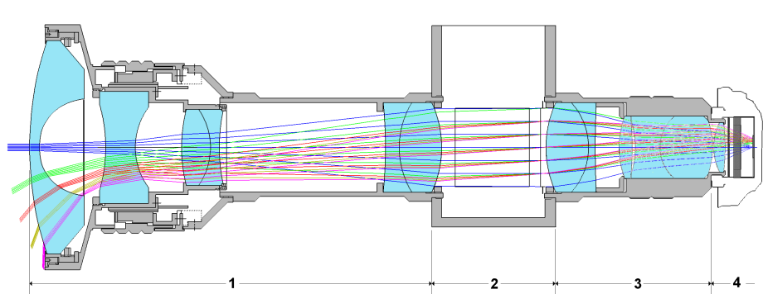
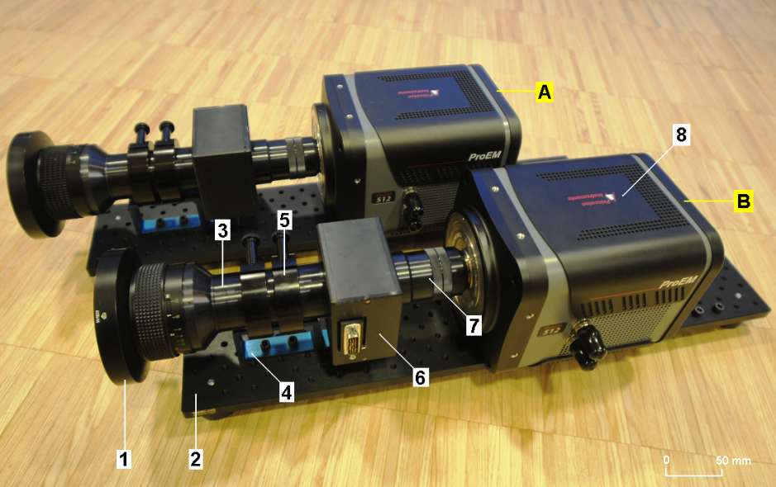
Norwegian and Russian Upper Atmosphere Co-operation On Svalbard (NORUSCA)
NEW TYPE OF INSTRUMENTS
EXAMPLE 3: no. 1 NORUSCA
Liquid Crystal Tunable Filters (LCTFs).
Based on the Lyot filter (stack of birefringent plates).
“The ability to electronically tune the band pass wavelength of these filters throughout the visible electromagnetic spectrum makes them an ideal candidate for hyperspectral imaging”
Cost: 1 MNOK

Slide 22
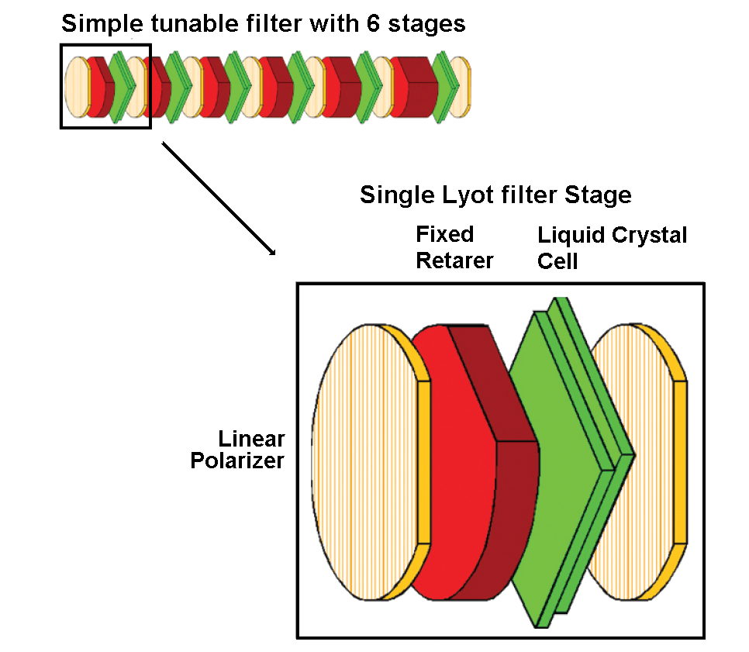
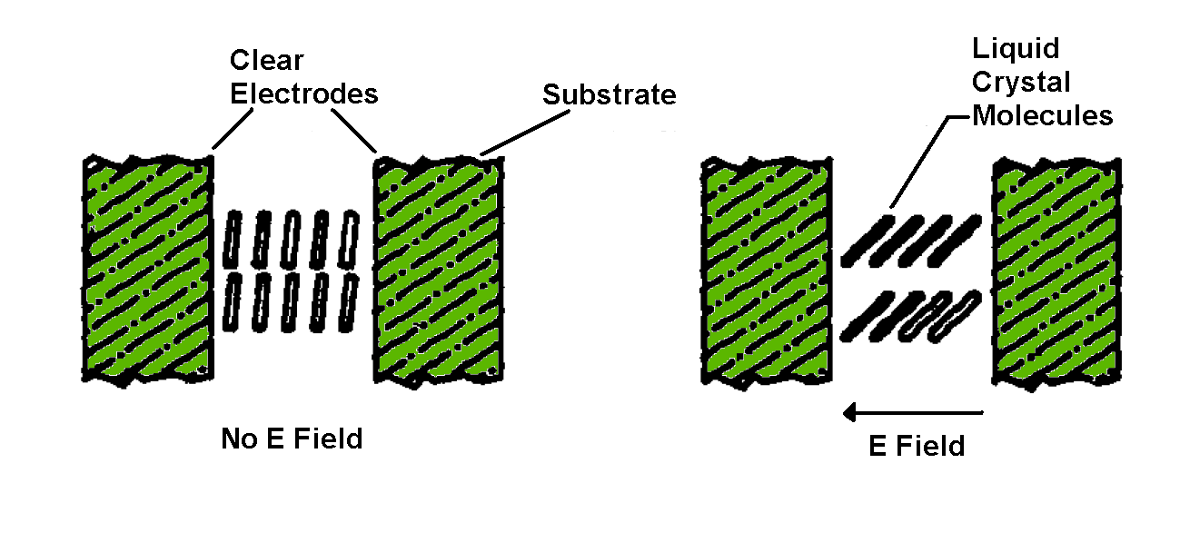
Filter: Liquid Crystal Tunable Filter (LCTF) (Cambridge Research & Instrumentation, Inc.).
Spectral tuning is obtained by using electronically controlled liquid crystal wave plates to a Lyot filter design*.
The wave plates behave as optical birefringent elements with an electrically variable retardance.
Retardance is termed the optical path difference between the ordinary and extraordinary rays passing through a birefringent element.
The latter is controllable due the effect that the liquid crystal molecules are orientation sensitive to electric fields applied between the plates. Since the retardance is directly linked to wavelength, the filters are tunable.
Our filter: 400–720nm FWHM=7nm @ 550nm
*P. J. Miller, “Use of Tunable Liquid Crystal Filters to Link Radiometric and Photometric Standards”, Metrologia 28, 145 – 149 (1991).

Slide 23
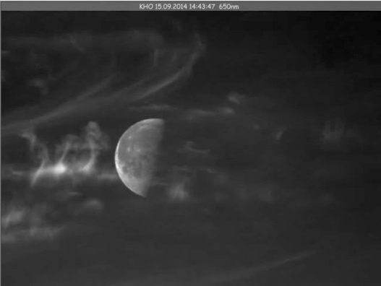
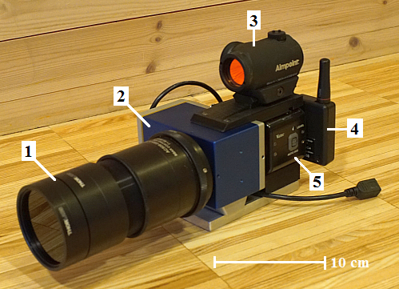
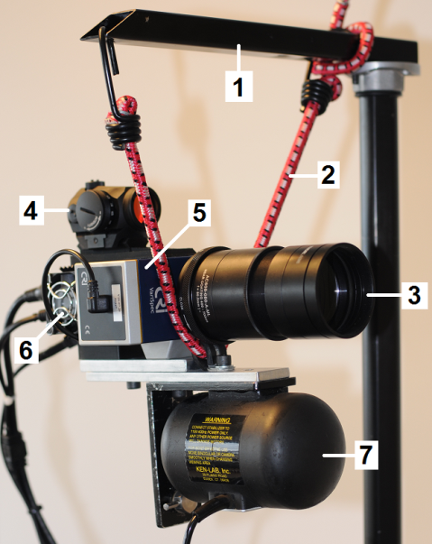
NEW TYPE OF INSTRUMENTS
Snapshot of moon at 650 nm
EXAMPLE 4: Narrow field of view Hyperspectral LCTF camera
Gyro rig: (1) mount arm, (2) elastic rope, (3) lens, (4) aimpoint, (5) Varispec filter, (6) camera head, and (7) hand held gyro stabilizer.
Prototype hyperspectral camera: (1) lens, (2) Liquid Crystal Tunable Filter (LCTF)- Varipsec, (3) aimpoint, (4) radio controller of camera head, and (5) Astrovid camera head.
Note that stabilization did not
work airborne!

Slide 24
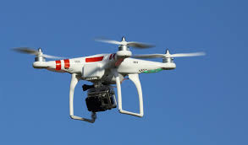
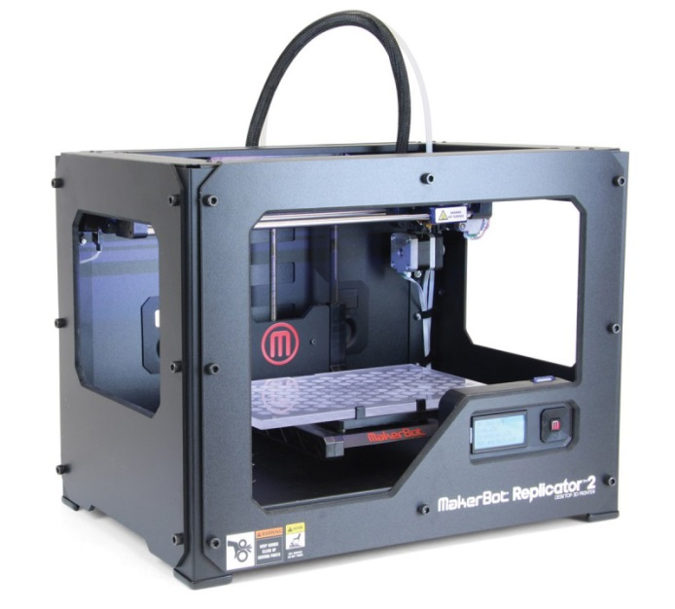
LOW COST DEVELOPMENT < 50 kNOK
Motivation
1. It now cost less to buy a drone than hiring a
airplane or helicopter for one hour.
2. Low cost camera system with stabilization
has been developed for and by the RC
community.
3. New high sensitive detectors available
(Surveillance, astrophysics, auroral, RC …).
4. 3D printing makes prototyping instruments
a) low cost, ref point 1.
b) low weight / mass.
c) small size.
d) fast …
DJI Phantom (2006) and the GoPro (2002)
MakerBot Industries (2009)

