Slide 1
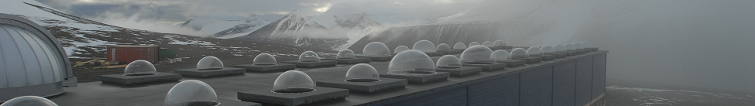

The Kjell Henriksen Observatory (KHO) 2014 - 2015
Fred Sigernes, Lisa Baddeley, Dag Lorentzen, Margit Dyrland, Silje Eriksen Holmen, Xiangcai Chen, Pål Gunnar Ellingsen, Noora Partamies and
Mikko Syrjäsuo
The University Centre in Svalbard (UNIS), N-9171 Longyearbyen, Norway
Birkeland Centre for Space Science (BCSS), Bergen, Norway
Abstract: The following is a summary for the activity at the Kjell Henriksen Observatory (KHO) for the 2014-2015 season. The current active personnel of the observatory are presented together with the operational instruments. A brief summary of the progress of the new Super Dual Auroral Radar Network (SuperDARN) radar is given in addition to project highlights from the Cusp Region EXperiment (C-REX) rocket mission and the Total Solar Eclipse campaign.
6th Birkeland Centre for Space Science (BCSS) meeting, 30.08-01.09.2015.

Slide 2
The observatory crew
Name | UNIS position | E-mail
Fred Sigernes | Professor, Optics and atmospheric Research, Head of The Kjell Henriksen Observatory | freds@unis.no
Mikko Syrjäsuo | Head engineer | mikkos@unis.no
Noora Partamies | Associate Prof. Middle atmospheric physics | noorap@unis.no
Dag Arne Lorentzen | Professor, Upper polar atmosphere Head of the SuperDARN radar project | dagl@unis.no
Lisa Baddeley | Associate Professor, Radar applications, Head of the Doppler Pulsation Experiment | lisab@unis.no
Margit Dyrland | Post Doc, Middle atmospheric physics | margitd@unis.no
Silje Eriksen Holmen | PhD candidate, Middle atmospheric physics | siljeh@unis.no
Xiangcai Chen | PhD candidate, Aurora physics | xiangcai.chen@unis.no
Pål Gunnar Ellingsen | Post Doc, Space physics | pale@unis.no
Table 1. The Kjell Henriksen Observatory crew (2014-2015).
Our Norwegian Construction and Property Management Department in Longyearbyen contact is Tommy Frantzen (tofr@statsbygg.no).

Slide 3
Operational instrumentation The instruments at KHO are grouped into mainly 5 categories (#):
All-sky cameras and narrow ﬁeld of view imagers,
Meridian scanning photometers,
Spectrometers / spectrographs
Scanning / imaging interferometers
Radio or non-optical instruments
During the auroral winter season from November to the end of February, 27 optical instruments operate 24 hours a day. The 10 non-optical instruments run all-year-round 24 hours a day. 21 different institutions from 9 nations are present at KHO. Note that out of 30 instrument domes; only four are currently not in use.

Slide 4
 | Instrument @ KHO | Institution | # | Country
1 | All-sky imager | University of Oslo (UiO) | A | Norway (NO)
2 | All-sky intensified video camera | University Centre in Svalbard (UNIS) | A | NO
3 | All-sky intensified camera | Finnish Meteorological Institute (FMI) | A | Finland
4 | All-sky color camera | University College London (UCL) | A | England
5 | All-sky video camera | UNIS | A | NO
6 | All-sky DSLR camera | UNIS | A | NO
7 | All-sky Airglow Imager | UNIS | A | NO
8 | Auroral meridian spectrograph | National Institute of Polar Research (NIPR) | C | Japan
9 | CCD spectrograph | Embry Riddle Aeronautical University (ERAU) | C | USA
10 | Spectrographic Imaging Facility | The University of Southampton/UCL | C | England
11 | Meridian-Scanning Photometer | University of Alaska Fairbanks/UNIS | B | USA/NO
12 | 1m S.Ebert-Fastie spectrometer | University of Alaska Fairbanks/UNIS | C | USA/NO
13 | 1m G.Ebert-Fastie spectrometer | University of Alaska Fairbanks/UNIS | C | USA/NO
14 | 1/2m B.Ebert-Fastie spectrometer | University of Alaska Fairbanks/UNIS | C | USA/NO
15 | 1/2m W.Ebert-Fastie spectrometer | University of Tromsø (UiT) | C | NO
16 | Michelson Interferometer | ERAU | D | USA
17 | Fabry-Perot interferometer | UCL | D | England
18 | Scanning Doppler Imager | UCL | D | England
19 | Monochromatic Auroral Imager | Polar Research Institute of China (PRIC) | A | China
20 | All-sky Airglow Imager | University of Electro-Communications (UEC) | A | Japan
21 | Fluxgate magnetometer | UiT | E | NO
22 | 2-axis search coil magnetometer | Augsburg College/Univ. of New Hampshire | E | USA
23 | Fluxgate magnetometer | PRIC | E | China
24 | Auroral Radio Spectrograph | Tohoku University | E | Japan
25 | HF acquisition system | Institute of Radio Astronomy/UiT | E | Ukraine/NO
26 | 64xBeam Imaging Riometer | Danish Meteorological Institute (DMI)/UiT | E | Denmark/NO
27 | Balloon Telemetry Station | Nobile/Amundsen - Stratospheric Balloon Center/Italian Space Agency | E | US/Italy
30 | Hyperspectral tracker (Fs-Ikea) | UNIS | C | NO
31 | All-sky hyperspectral camera | UNIS | C | NO
32 | Narrow field of view tracker | UNIS | A | NO
33 | Scintillation and TEC receiver | University of Bergen (UiB) | E | NO
34 | Automatic weather station | UNIS | E | NO
35 | 4xWEB cameras (safety) | UNIS | A | NO
36 | Celestron 4m Telescope | UNIS | A | NO
37 | Internet radio link - Janssonhaugen | NORSAR | E | NO
Table 2. Instruments at the Kjell Henriksen Observatory (2014-2015).

Slide 5
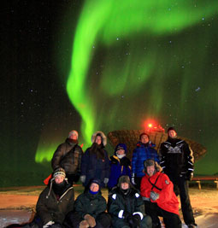
Teaching and courses
KHO serves as the main laboratory for hands on training and teaching of students in the Space physics group at UNIS.
Fig. 1 show students on field work using both the EISCAT radar and KHO. They used state-of-the-art facilities to do in-situ observations of the aurora.
The following 4 courses have used KHO as part of field work:
Fig.1. AGF-345 students at Breinosa. Photo: Njål Gulbrandsen
Code | Course name | ECTS
AGF-216 | The Stormy Sun and the Northern Lights | 5
AGF-301/801 | The Upper Polar Atmosphere | 15
AGF-304/804 | Radar Diagnostics of Space Plasma | 15
AGF-345/845 | Polar Magnetospheric Substorms | 10
Table 3. UNIS courses using KHO as laboratory (2014-2015)
A grand total of 45 ECTS (European Credit Transfer and Accumulation System) have been taught per year.

Slide 6

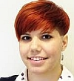
Graduated students
(1) Dr. Holmes, I presume?
A new protonic is born! Jeff Morgan Holmes has defended at the University of Oslo (UiO) his PhD titled:
The Protonics project: distributed observations of auroral dayside Doppler-shifted hydrogen emissions. KHO salute you!
(2) Master Kinga
Congratulation to Master Kinga Albert! The thesis is called: Svalpoint: A multi-track optical pointing system.
It enables us at KHO to track any object on the night sky with multiple instruments, simultaneously. Her work opens new opportunities for us and we really look forward to start using the system.

Slide 7
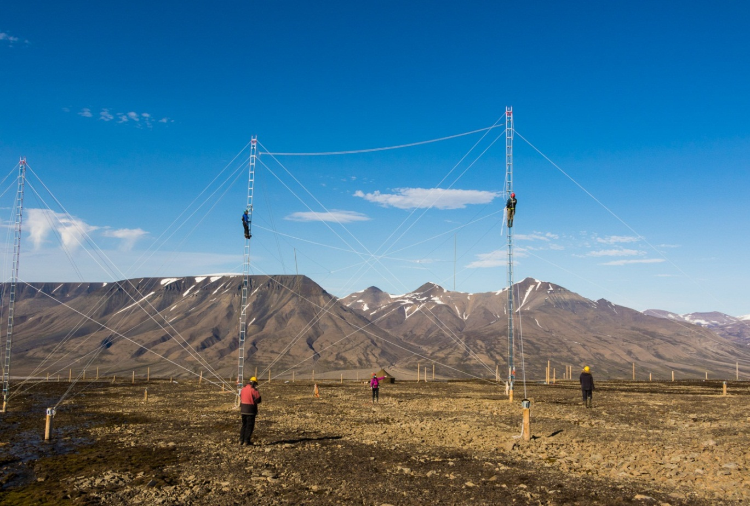
The Svalbard SuperDARN (Super Dual Auroral Radar Network) HF Radar
Status
Masts raised
Power / data fiber installed
Antennas mounted
All as planned!
Fig. 2. The SuperDARN radar under construction. Photo: Mikko Syrjäsuo/UNIS.
The transmitter units will arrive soon and will be connected at the site in September. SuperDARN will be operational in October 2015!.

Slide 8
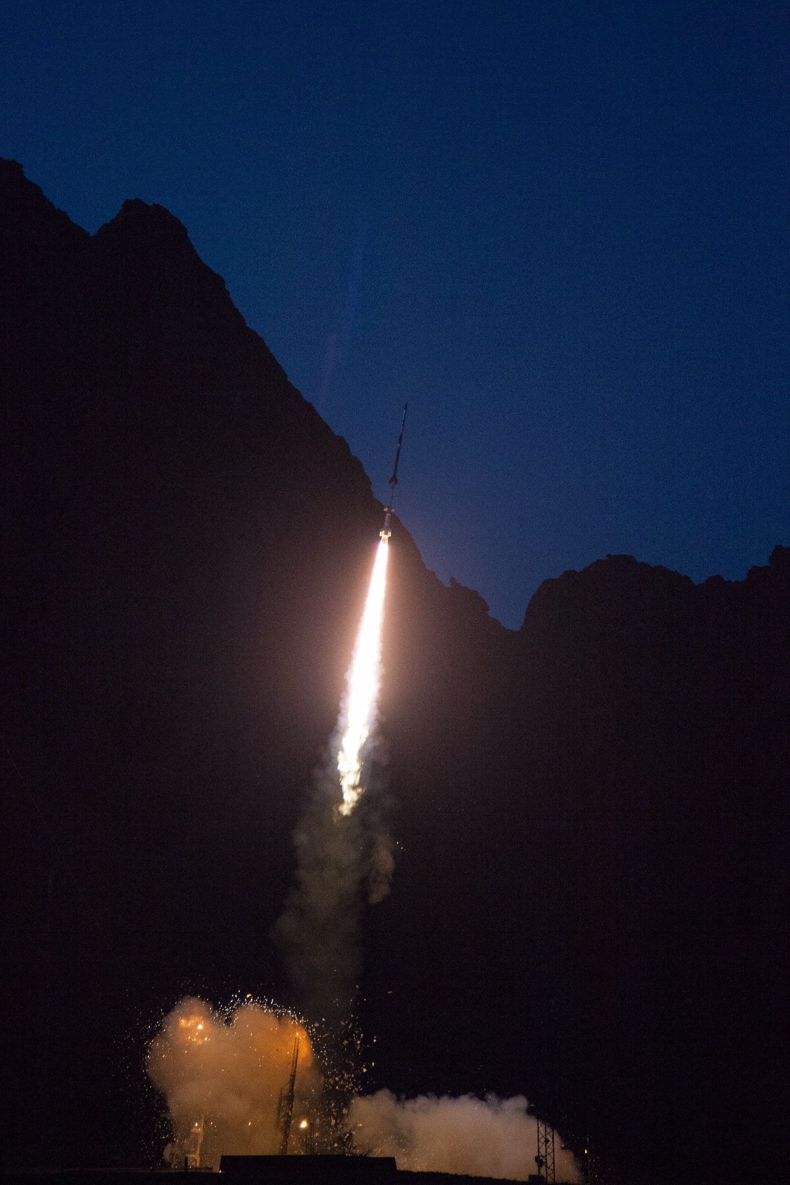
The Cusp Region EXperiment (C-REX)
KHO was a central part of the Cusp Region EXperiment (C-REX), a NASA sounding rocket mission that released a large constellation of artificial clouds into the ionosphere above the Greenland Sea.
The rocket was launched from Andøya Space Centre at 08:05 UT on 24th of November, 2014.
Fig. 3. NORUSCA II all-sky color composite images from KHO, 24.11.2014. The Red, Green and Blue color channels are from center wavelengths 6300, 5577 and 4861 Å, respectively.
Labels (A) to (D) represent time from 08:14 to 08:17 UT. Jupiter is marked with arrow (1) in panel (A). Arrow (2) in panel (B) marks the first releases of the artificial clouds from the C-REX rocket.
Fig. 4. Launch of the C-REX rocket from Andøya. Photo: Brea Reeves.

Slide 9
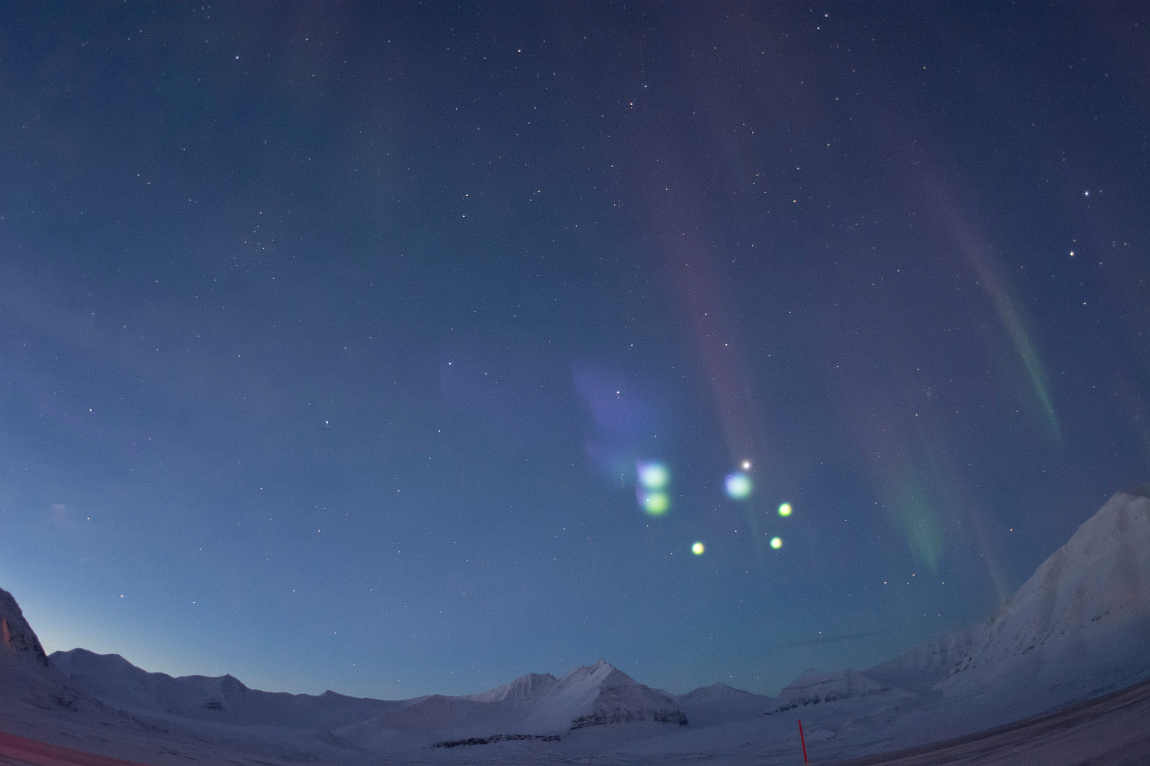
The rocket ejected 10 sub-payload canisters loaded with Barium and Strontium vapor.
When released and illuminated by the Sun, both ion and neutral barium emission lines appears visible to the human eye.
Altitudes: 190 - 400 km
Fig. 5. C-REX releases as seen from Ny-Ålesund. Photo: Manbharat Dhadly.
Large velocity difference between the neutral and ions has been detected, which is believed to produce Joule heating. No clear indication of upwelling is detected yet.
A new mission called C-REX2 is proposed to address these issues in more detail in order to fully explain the high density anomaly in the cusp thermosphere region.

Slide 10
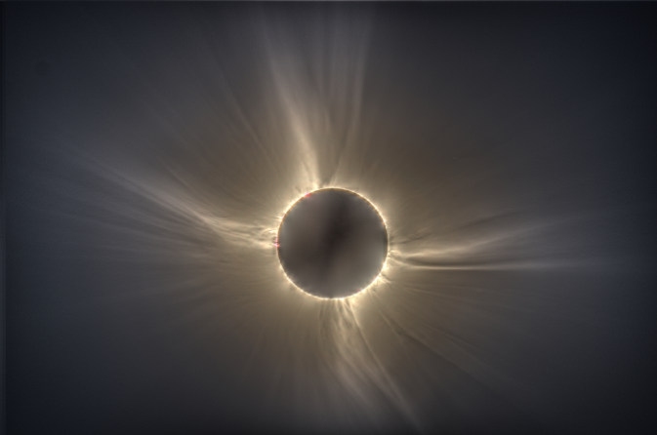
The total solar eclipse campaign on Svalbard 2015
The total solar eclipse on Friday 20th March 2015 started in the western Atlantic, 650 km west of Canada's Labrador coast and 450 km south of the southern tip of Greenland.
It then raced across the Atlantic ocean touching land at only two places: the Faroe Islands and Svalbard.
The totality started at 10:13:43 UT and lasted only 147 seconds.
Fig. 6. High Dynamic Range (HDR) image of the total eclipse from Nordlysstasjonen
The UNIS Campaign:
 | Objective | Site | PI
1 | Teaching (AGF-216) | UNIS | P. Brekke
2 | Public outreach | UNIS | P, Brekke
3 | Coronal imaging | Nordlysstasjonen | P.G. Ellingsen
4 | Auroral measurements | KHO | S.E. Holmen
5 | Airborne hyperspectral imaging | Dornier | F. Sigernes
6 | Coronal dynamics and spectra | UNIS | J. Pasachoff
7 | High resolution spectra | Nordlysstasjonen | S. Habbal
Table 4. The total eclipse
team at UNIS.
Nordlysstasjonen refers to the old Auroral Station in Adventdalen.

Slide 11
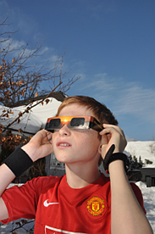
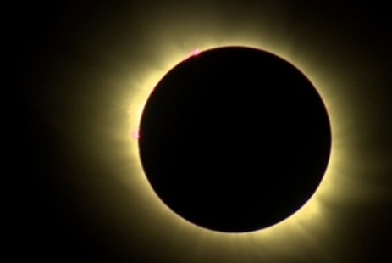
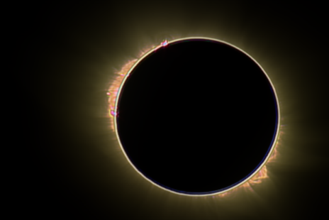
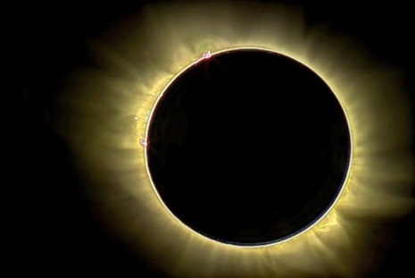
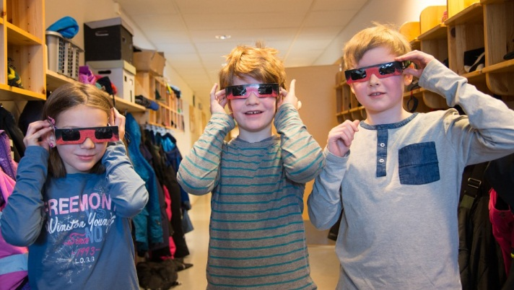
A new video accumulation technique
Fig. 7. Accumulated video highpass cascade filter technique applied to live broadcast from NRK of the total solar eclipse on Svalbard 2015. Left: Stabilized summation of 448 video frames (raw image). No filter applied. Middle: Accumulated frames with 5x5 pixel highpass cascade filter. Right: Accumulated 3x3 highpass cascade image fused with raw image.
Fig. 8. Boy with eclipse glasses. Photo: Pål Brekke.
Fig. 9. Videos and images in the media

Slide 12
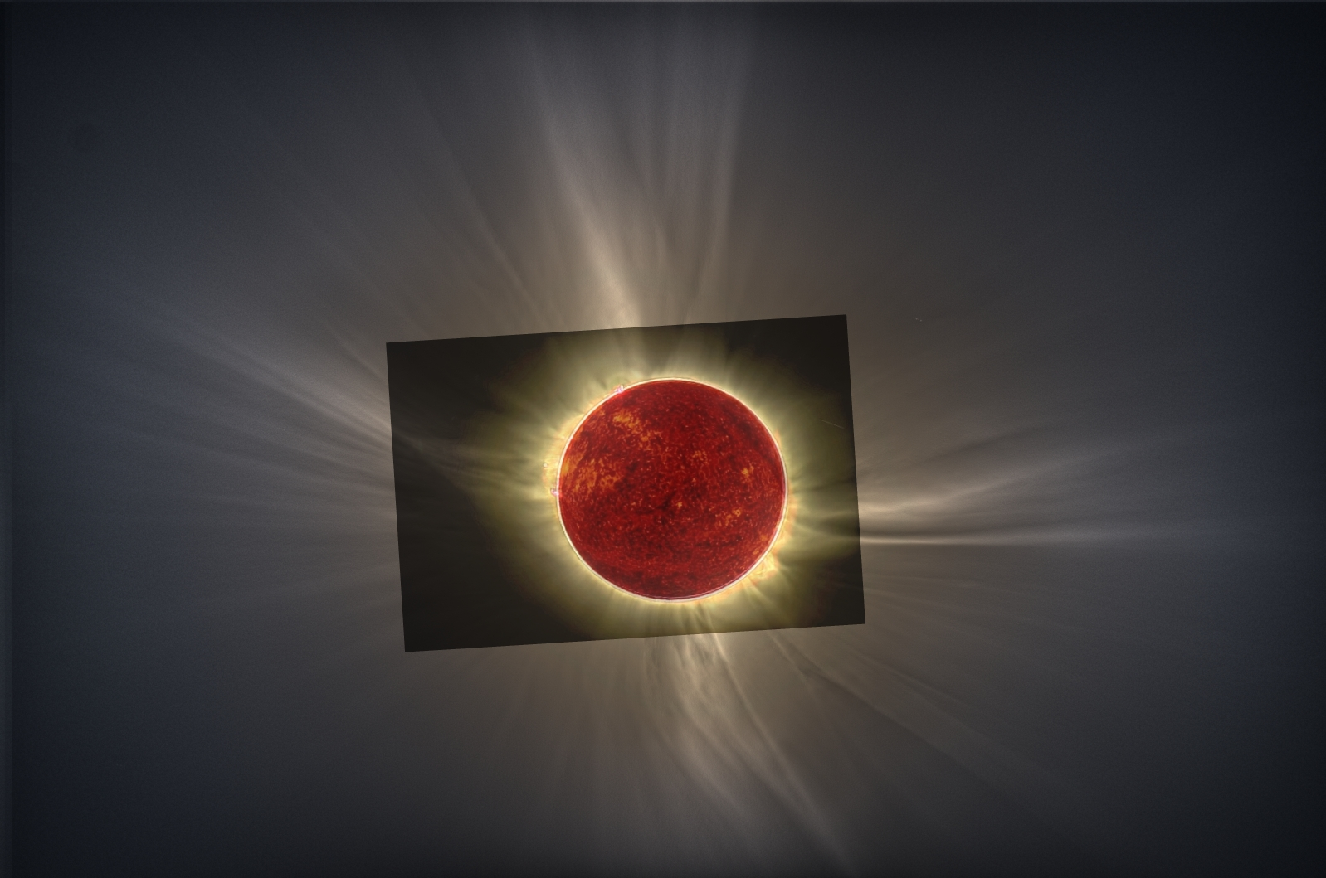
Fig. 10. High Dynamic Range (HDR) image fused with the highpass cascade video sequence from NRK and the Solar Dynamics Observatory (SDO) image at 304 nm.

Slide 13
10 x Other highlights …
UNIS held Norway’s first international SuperDARN meeting in May 2014.
Her Royal Majesty Queen Sonja of Norway revisited KHO 5th of February, 2015.
AGF-304/804 Master and PhD students provided radar support for the University of Oslo sounding rocket named ICI-4 that was launched successfully from Andøya Space Centre at 23.06 LT on 20th of February, 2015
The Nordic optical intercalibration workshops in Sodankylä, September 2015
A new HF transmitter is deployed to Hornsund to study small scale ionospheric and gravity waves. The receiver will be deployed at KHO this fall.
The 42nd Annual European Meeting on Atmospheric Studies by Optical Methods (42AM), Hermanus, Western Cape, South Africa, September 14-18, 2015.
The Russian NORUSCA camera goes back to Barentsburg in September 2015.
KHO supports the RENU2 (Rocket Experiment for Neutral Upwelling 2) fall 2015.
New rocket proposals: VISION2 and C-REX2
Publications and presentations (talks) numbers are sofar 10 and 27 for the time period 2014 – 2015, respectively.

Slide 14
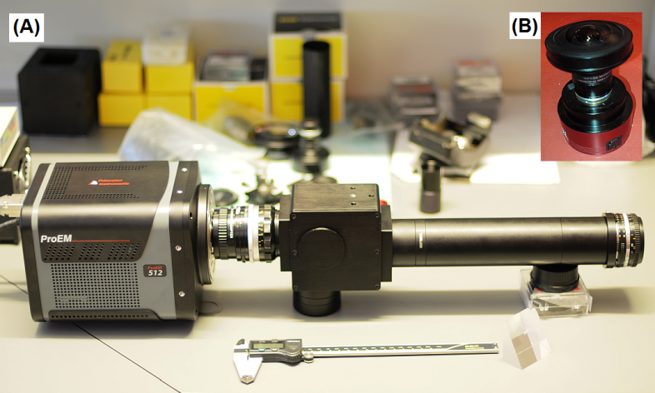
New instruments …
The season has 2x expanded
due to BCSS and high activity.
There is a need to operate instrument during periods with high background sky illumination when for example the moon is up. This forces us to develop instruments with increased dynamic range without damage to the detectors.
Fig. 11. New instruments at KHO 2015.
A Meridian Imaging Svalbard Spectrograph (MISS) will be tested next season and compared with our Meridian Scanning photometer (MSP).
A low cost F/1.4 color all-sky camera with the new back illuminated CMOS (Sony IMX174) sensor designed to operate especially for Sun and Moon imaging will be tested.
Future?

